Slide 1
ForYou Q&A
Good Experience:
快速獲得數個大廠的採用
1. JP : 3 major customers
2. 歐 (M) , Clarion M, 鴻海 (1+2) , AUO
3. Desay ( 吉利, 4 models ) , HSAE(Nissan 3 models) , 聯友 ( Nissan 1 ) ,
Note: 客戶appreciate順利通過 ITU-T 及車廠認證速度, 遠勝他家產品
優點:
1. 優異的 Algorithm : 難以處理的 Double Talk…
2. 完整的IOP ( Total System IOP) :
大中小型車實車路試; 高速公路,平面道路,山路及崎嶇道路路試; 強風,大雨,打雷極端天氣路試;
車內環境音干擾測試(AC, 導航音量….) , 語音辨識(VR)
解決極端情境下的語音清晰度與穩定性;
3. Intelligent & Real-Time Tuning Tool :迅速調出更準確, 滿意的結果, 克服重要項目手工調整的缺點
    CP SWB Receive/Send Speech quality 測項:
    需多次嘗試調整 EQ 提高 MOS 分數，此 Tool 可根據 ACQUA 音檔比對 EQ 差異，自動調整 EQ 以提高 MOS 分數。
    RES (Residual Echo Suppressor) 參數的調整:
    須同時考慮 TCL 及 Double talk 測項，Tool 可自動嘗試多種參數組合得到較佳設定。
    自動量測 Reference 信號和 TXin (Mic_in) 信號之 delay，並給出建議。
    自動嘗試不同 Echo tail 設定，並建議最佳設定值。

Slide 2
4. ITU-T Tool: 完美的協助客戶, 提前辨識與解決問題. 如 Bulk Delay, Sample Rate Mismatch, Speaker/MIC失真…
    Round Trip Delay ( RTD )
    Speech Quality During Single Talk
    Out-of-band Signals
    Echo performance without BGN
    Spectral Echo attenuation
    Double talk performance
  5. 協助CP/AA : 提高語音辨識率 , 通過其 ITU-T 的測項
三 Extra Service:
1. 一個特別打造的機器 :可進行實車的驗證
2. 各種車機系統可能碰到的問題, A&W 也盡可能項辦法協助, 一起克服.
ex: 麥克風/喇叭線性度不佳、
參考信號至麥克風信號延遲不穩定、
參考信號與麥克風信號採樣率偏差、
車輛空間混響…

Slide 3
ForYou Q&A
產品 :
BT Stack :
已建立一個完整平台 :包含客戶常用的主要 SOC (Telechips, MTK, 瑞芯微…) 及 BT Chips (NXP, Infineon…)
1. 基本功能驗證 : 從上層 BT APP 到 BT SDK ( 包含 Native ) 都可以測試
2. POC : 特定的 performance 驗證, 特殊功能的 verification ,複雜連線
3. System Throughput or BT Chip limitation 的事先測試驗證 等,
這些可以用來輕易的釐清與客戶 co-working 時的問題 root cause , 如 APP , BT SDK , BT chip limitation, 系統問題( ex:
UART/ Audio driver) 或系統設置 ( ex: Priority ..) or 手機本身的問題….
CP/AA:
已建立一個完整平台:包含客戶常用的主要 SOC (Telechips, MTK, 瑞芯微…) 及 Combo Chips (NXP, Infineon…)
1. Resource : 從模擬上層APP 做 Resource Management : 確認 Resource 管理 Spec, 解決 Video , Audio , 混音等問題
2. Device : CP/AA/BT 等連線管理機制(Device Management) : 解決 Connection , Disconnection , Reconnection 機制
3. System Optimization: RTD( Round Trip Delay); ITU-T; SiRi;
4. Combo Chip 的 USB / WiFi driver performance
5. New Function : Cluster view , Dolby .. 的開發驗證
這些可以用來確認客戶的 CP/AA 的操作行為 Spec, Performance , Pass Certification

Slide 4
ForYou Q&A
產品 :
ECNR:
做一個 Evaluation Device (瑞芯微): 可進行實車的驗證評估
1. Driving IOP : Speed , Window open / close , Engine , Road , Rain..
2. Intelligent Tuning Tool : 自動的 Parameter 值的設定
3. Testing Tool : 模擬 ITU-T, 進行critical 測項(ex:Speech Quality During Single Talk, Double talk Performance…)驗證,
提早與客戶釐清修正車機的系統問題 ( 含 RTD ) , 解決實際車內裝配對測試的影響, 如 SPK . 座位的材質…
服務 :
ForYou: Module (ex: 信華) 合作案例:
透過 BT Stack 完整平台, 釐清及解決 BT Application , BT SDK , BT Chip limitation or firmware 問題
.
CPAA : 整體系統平台( Top -> Down )
1. 解決與客戶接合問題 : Resource / Device Management , USB / WiFi Driver , BSP ( Audio / Video )
2. System Optimization : RTD , ITU-T , SiRi, Facet , PCTS….

Slide 5
ForYou Q&A
價格:
如果項目在藍牙需求只要基本功能(Like HFP,PBAP,A2DP/AVRCP)以最親民價格提供.
PLG solution 不管幾種組合使用都是提供高品質,優質技術,高CP值價格.
JK 關係 :
除了外包整機給 ForYou 外, 內部開發之產品長期都是用 A&W 的 , 對 A&W 的品質非常滿意.

Slide 6
Reference Data

Slide 7
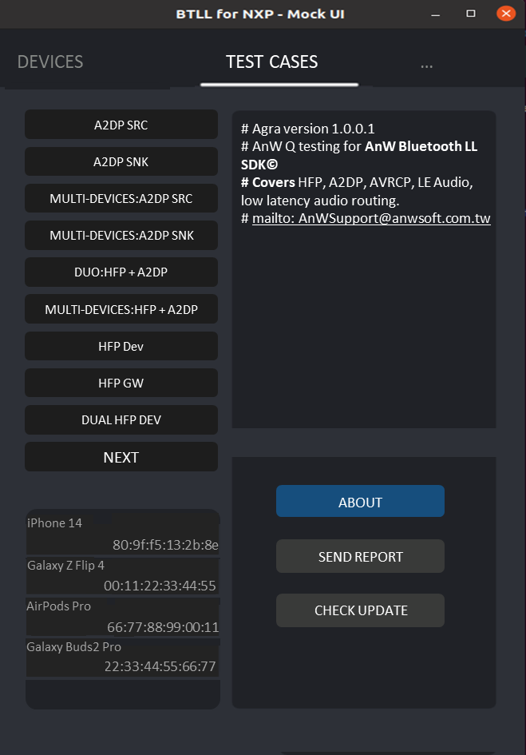
A&W POC
A&W POC is designed to verify limitation, capability, audio quality of BT/Wi-Fi chip or modules as a first-line validation tool. New test case can be easily added or expanded on the Customer demands
Test Case: Expandable
A2DP SRC
A2DP SNK
Multi-Device: A2DP SRC
Multi-Device: A2DP SNK
DUAL: HFP + A2DP
Multi-Device: HFP + A2DP
HFP Dev
MULTI-DEVICES: HFP DEV
SCO Bridge (HFP DEV + GW)
HFP GW
A2DP SNK + PBAP
HFP Dev + PBAP
A2DP SNK + MAP
HFP Dev + MAP
A2DP SNK + SPP
HFP Dev + SPP
2SPP (test ok)
BLE GATT
BLE Profiles: PXP, HRP, …etc
LE Audio
MultiDev HFP GW + GW
A2DP+Multi BLE
Intercom between passenger & driver

Slide 8
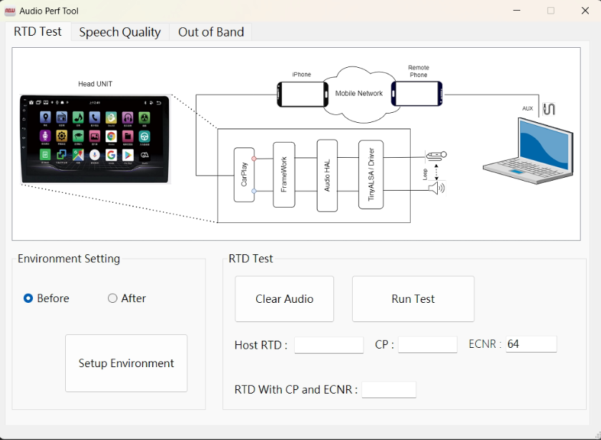
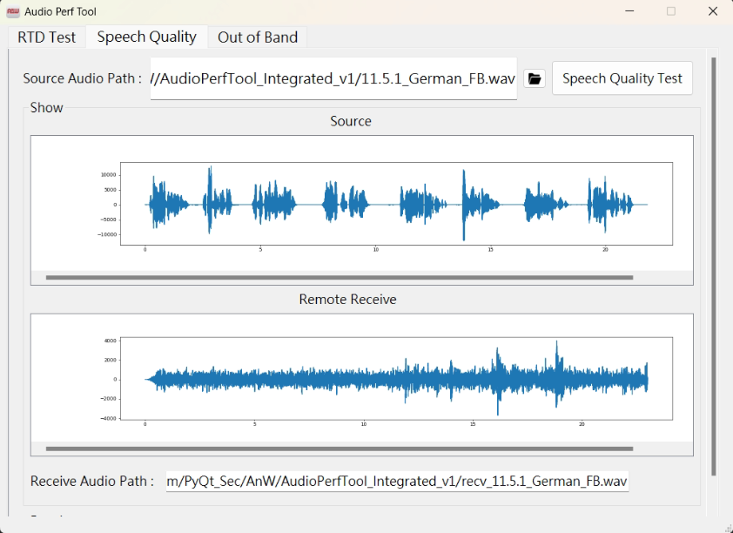
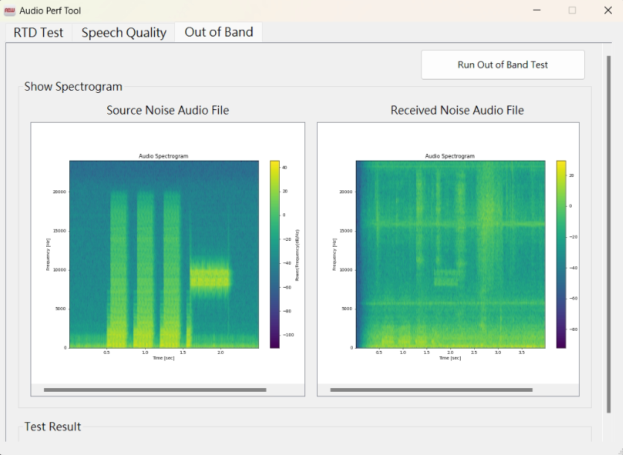
Examining Tool ( ITU-T)
  Round Trip Delay ( RTD )
  Sensitivity Frequency response
  Loudness Ratings
  Speech Quality During Single Talk
  Idle Channel Noise
  Out-of-band signals
  Echo Performance without BGN
  Double talk Performance
  Speech quality in the presence of BGN
  Absolute noise level
  DTMF cancellation

Slide 9
CarPlay: ITU-T
Function | Key Influencing Factors | Challenges | A&W Advantages / Countermeasures
Round Trip Delay | Audio Framework Path / Speed Bulk Delay | CP ITU-T: Round Trip Delay Android system Wireless: < 415ms | Audio Framework Path Optimization Lower Latency : ECNR.. Wireless: < 350 ms
One Way Talk | SPK: Non-linear , Distortion, Max Volume Saturation, audio glitchy MIC System: Pre-process e.g. NR Low volume, bad EQ Program : pop , Signal Linearity… Data packet loss or harmonics caused by sampling rate conversion Influence of interior space in the car Frequency | Speech quality during single talk 11.05.1 One Way Speech Quality in SND (TMOS) | Program: Issues in the software integration process (buffer size, clock, microphone sound dropouts, harmonics, etc.) e.g., Insufficient buffer size causing dropouts or popping sounds, resampling leading to harmonics and distortion ECNR Algorithm: EQ The most important advantage: Ensuring double talk and echo, A&W can adjust the uplink sound to match the volume and quality of a direct phone call made on a mobile phone. It is almost indistinguishable from using the car system during a call.

Slide 10
CarPlay: ITU-T
 | Key Influencing Factors | ITU-T Difficult test items | A&W Advantages/ Solutions
Echo Cancellation | SPK , MIC Reference data Gain VS MIC-in Gain | Echo performance without background noise 11.11.3 Spectral Echo Attenuation (nominal) 11.11.1a Terminal Coupling Loss (TCLw), MAX | Compare the audio data produced by the PC with the audio data produced by the car system: compare waveforms, analyze/find the issues, and provide recommendations. ECNR Algorithm: Reference data Gain Bulk Delay , Echo tail length, Residual Echo suppression
Double Talk | SPK , MIC Bulk Delay Echo tail length Residual Echo suppression | Double talk performance 11.12.1(1) DT- Attenuation Range-SND Max Volume | ECNR Algorithm The driver's side audio is clear, without overlapping sounds or issues related to the interaction with echo cancellation. Bulk Delay , Echo tail length, Residual Echo suppression

Slide 11
CarPlay: ITU-T
 | Key Influencing Factors | ITU-T Difficult test items | A&W Advantages/ Solutions
Background Noise | Noise, e.g., engine noise, air conditioning, wind noise, rain sound, fan noise… Each metric affects one another, the noise is close to human voices, the noise is extremely loud, making it very difficult to calibrate. | 11.13 Background noise transmission BGNT Level, Lombard Effect Factor EN Speech Quality BGN GMOS Check Noise Quality EN NMOS Check Speech Quality EN SMOS | ECNR Algorithm: Noise processing is done very well High-quality calls can be ensured even in very noisy environments, without a noticeable drop in sound quality due to extracting voices from loud background noise.
Out-of-band | Related to the system DSP (DAC / ADC) filter settings (which may create harmonics during the resampling process, causing high-frequency sounds to be perceived in the low-frequency range). | 11.08 Out-of-band signal 11.08.1b Out-of-band signals Sending NBS(4KHz) & WBS(8Khz). | A&W Tool Check: Follow the test method in 11.8.1 -> Play P.501 clause 7.3.2 voice as the reference level -> Play 8-10kHz white Gaussian noise -> After microphone recording, check that the 200-7kHz level should be at least 35dB lower than the reference level Check if the customer system generates abnormal harmonics Verify if out-of-band signals affect in-band signals e.g., incorrect SoC DSP filter settings

Slide 12
CarPlay : Certification
Function | Key Influencing Factors | Challenges | A&W Advantages / Countermeasures
Resource Manager Audio source switch Video source switch Audio + Video | Switch error : Broadcast / Interact per APP Audio / Video status error Delay : Video. Audio, Navi, MIC Brief black-and-white screen | Facet: Uniform Rules : Broadcast / Interact … Protected : Resource permissions… Quick Phone Switching | Resource Manager : Centralization: Avoiding Competition for Resources Layered usage: Manage resources in layers Resource Synchronization Optimization : Audio / Video flow
Device Manager Proxy Multi-Phones: Device status / information | Multi Mirroring AP : CP , AA , HiCar…Interaction issues Bluetooth , iAP2, WiFi, USB Interaction issues | Facet Reconnect < 3 Secs CarPlay Connection - Multiple IOP issues: different iOS, iPhone Connection Stability: BT, CP, AA, Switching CarPlay : Bonjour, New protocol | Device Manager Proxy: Controller Resolve connection conflicts / Reconnect issues, etc. A&W MM ( BT , CP , AA… ) : Optimize connect speed flow Optimize to resolve BT/CP: IOP issue

Slide 13
CarPlay : Certification
Function | Key Influencing Factors | Challenges | A&W Advantages / Countermeasures
Siri , Voice control MiC Always ON Voice Trigger ( Local VR ) Button Trigger | Music volume high ; Lot of Noise Audio Blank data: system's underlying layer. system contains blank data… Media playback was stopped." White Noise; DB level too low | Exceeding CarPlay ITU-T standards Leading Zeros > 150ms Max Zeros sequence > 15ms Media playback was stopped AudioStream SETUP over 100ms Voice recognition rate, Command Response time | Flow adjustment / modification: Use silent data. Increase the volume of the White Noise.. ECNR additional Function: Stereo Cancellation for VR
Local navigation (road testing) | Local GPS / GNSS : Blind guidance method ( Dead-Reckoning Method) Speed approaching 0: affects accuracy Large azimuth angle error, Insufficient sensitivity Neutral/ Drive /Reverse : Switch | Facet: Speed 0 : D/R modes Switching → Accuracy of azimuth angle logic Accuracy : Different GPP Location services are inaccurate: Poor weather , Tunnels… | Resolve D/R modes, azimuth angle errors, GPS accuracy Location data (altitude, longitude, latitude, speed, etc.) → NMEA (National Marine Electronics Association)
User Input | SPEC instructions 30 FPS / Sec 60FPS / sec | Facet 0BCE9: “ HID Send Report’ command is sent only when the button is pressed down and then when the user releases the button.” Send press and release buttons together | Process Optimize

Slide 14
Bluetooth Stack Check List - Android, Linux, RTOS
RFQ
POC
System BT Chip Advanced
IOP
Security
Certification
Others
Advanced:
LE-Audio
Multi-Connection
Auto-Parking
Audio Routing
SOC with 2 BT Chips
….
ACC ON / OFF Flow
UART Baudrate
Audio Driver
PCM Driver
Multi-Slot
Small Code /RAM when needed
Capability &
Limitation
Max Connection
2 / 3 SCOs
2 A2DP
Streaming
Classic + BLE +
LE Audio
…
Audio Routing
(HFP/A2DP)
A2DP + Multi BLE
A2DP(SRC)+LE Audio(CIS:SINK)
Classic + BLE + LE Audio
Mobiles
(Over 3700)
Headset
(Different Brands )
3rd Player
(Spotify, KKBOX, QQ…)
Defensics
Coverity
CVE
KNOB,
BIAS,
BlueBorne,
SweynTooth,
BlueFrag
BQB: PTS
BT Application
CarPlay
(OOB, EIR , iAP2..)
Android Auto
ECNR

Slide 15
CarPlay/Android Auto Check List
Function List
POC
System Combo Chip
IOP
Certification
Others
HeadUnit 3rd Party APP:
WeChat,Player…
Connectivity Mechanism
CP / AA / HiCar…
Resource Manager
Device Manager
Advanced:
Audio Routing
….
HID, GNSS,
USB Device Mode,
WiFi AP,
BT OOB, iAP2 MFi, Display,
H.264
ECNR:
Mic Variation, Round Trip Delay
Stereo EC
VR
Capability &
Limitation
BT / WiFi
Performance
Different Phone model / OS version,
Optimize:
Connection speed
Latency
Test Item:
Location Drive Test,
Enhance Siri Test,
Facet Pre-Test..
PCTS Pre-Test
SW ECNR
Increase VR Rate
ITU-T Telephony
Audio Quality Test,
VR
Notes:
This is flow of development for Bluetooth. Explain each by each.

Slide 16
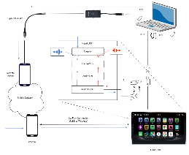
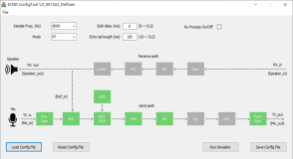
SW ECNR Check list
Function List
System Check
IOP
Tuning Tool
Certification
Others
EC :
Mono/ Stereo
NR:
Engine / Road Wind / Rain/ Air Condition…
Advanced:
Multi-Mics
Voice Activity Detection
Voice Enhancement
….
Audio Path
Mic
Max input Level
Clipping/Saturation
Speaker
ADC/DAC
Odd /Even
Harmonics
….
Car Speed
(0, 60, 100, ..)
Noise
Passenger Vice,
Pet Barking,
Music,
Engine,
Window,
Sunroof,
…..
Examining Tool
Off-Line Tuning
ITU-T
P1100, P1110, P1120
Small
Code/ RAM CPU Loading
VR
Siri / Google Assistant
Alexa

Slide 17
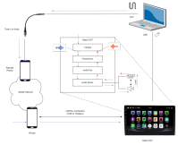
PLG Check List
Beginning Developing Integration SOP
RFQ
POC
System Chip Advanced
……
…
IOP
Security
Certification
Others
CheckList :
Bluetooth
CarPlay
CarLife
HiCar
Android Auto
ECNR
Mono/ Stereo
Voice Activity Detection
Connectivity Mechanism
CP / CL /HiCar…
Advanced
Classic+BLE+LEA
Multi-Connection
SOC with 2 BT Chips
RSE
…
Driver:
UART Baudrate
WiFi AP Mode
USB Role Switch
BT OOB,
iAP2 MFi
NCM Driver
GNSS
Audio :
PCM Multi-Slot
Audio Framework
Mic
Max input Level
Clipping/Saturation
ADC/DAC
Odd /Even Harmonics
Speaker
Non-linear , Distortion
Capability &
Limitation
Max Connection
2 / 3 SCOs
2 A2DP
Streaming
Classic + BLE +
LE Audio
…
BT / WiFi
Performance
Interference
Device Switching
Audio In/Out Selection
Audio Routing
Music
Phone Call
Classic + BLE + LE Audio
Rear Seat Entertainment
One Soc with
2 or 3 BT Chips
Mobiles
(Over 3500)
Headset
(Different Brands )
3rd Player
(Spotify, KKBOX, QQ…)
VR
Different accents
Car Speed
(0, 60, 100, ..)
Noise
Passenger Vice,
Pet Barking,
Music,
Engine,
Window,
Sunroof,
Cybersecurity
Defensics
Coverity
CVE
KNOB,
BIAS,
BlueBorne,
SweynTooth,
BlueFrag
ITU-T Tool
Off-Line Tuning
Mirroring:
Location Drive Test,
Enhance Siri Test,
Facet Pre-Test..
PCTS Pre-Test
BQB: PTS
BT Application
Audio Quality Test
VR
Siri
Google Assistant
Increase VR Rate
Alexa
Small Code /RAM when needed

Slide 18
Platform Experience
Platforms | Operating Systems
Qualcomm 820a/6155/7255/8155/8295/8775 | Android O/P /11/12/13/14
Qualcomm 8064, Snapdragon | Android, Linux
Telechips TCC89xx/88xx/8030/8050/8070 | WinEC, WinCE, Android / Android P/Android13 , Linux
NXP(Freescale) i.MX6, i.MX8 | Android O/P/10/11/12 , Linux, QNX CAR
Renesas R Car E2, E2x , M2, M3N | Linux , Android O/P/10/11
MTK2701, 2712,2715,2718 | Linux, Android P(MTK2712),Android 13, Android 15
Semidrive X9 series | Android 11/12

Slide 19
Experience
Bluetooth/Wi-Fi Connectivity Chipsets
Brand | Type | Model No.
Qualcomm | BT+WiFi Chip | QCA6564A, QCA6574A, QCA6696,QCA6688, QCA6698..
Infineon | BT+WiFi Chip | 43353, 43455, 89335, 88335, 89359,89373,88373, 89570..
NXP | BT+WiFi Chip | 8787, 8887, 8987, 9098, AW690, AW611,AW693..
Realtek | BT+WiFi Chip | 8822ES,8821CS,8723DS,8733BS..
MTK | BT+WiFi Chip | 6630, 7921
Realtek | Bluetooth HCI Chip | 8761ATV
Infineon | Bluetooth HCI Chip | 89071/2
Note : The color in Blue mean support LE Audio Chip

Slide 20
Advanced function POC

Slide 21
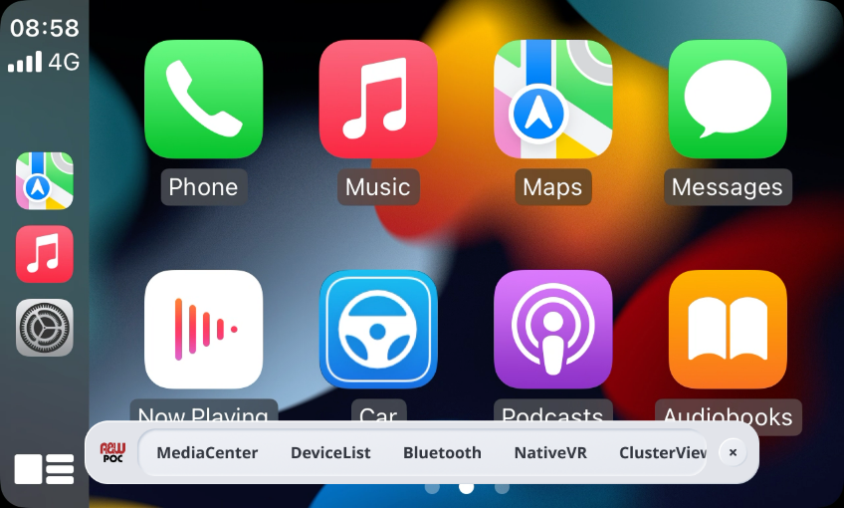
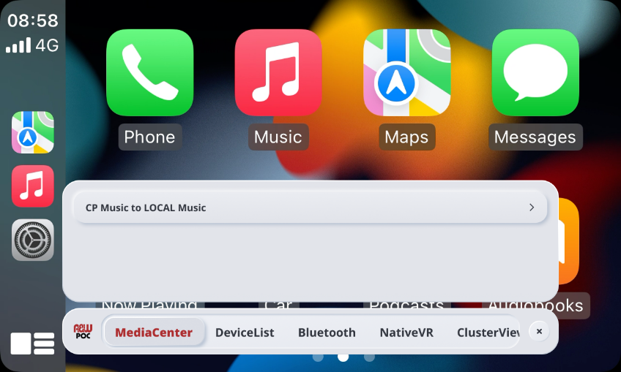


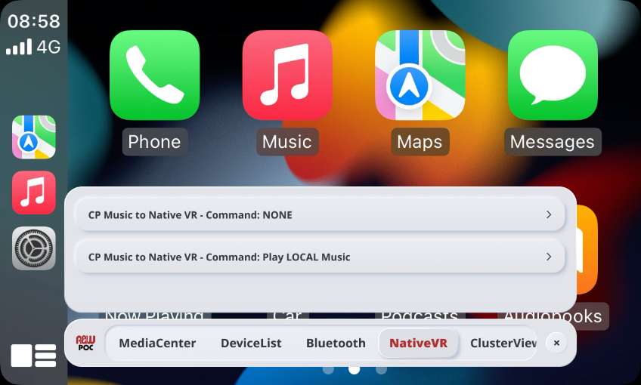

CPAA

Slide 22



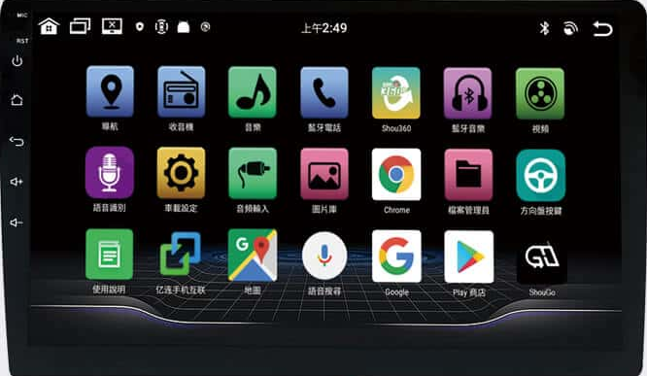

CLASSIC (Advanced) ANW BT / NATIVE (Advanced)
Multi-Connection:
Mobiles, Headsets, and BLE devices ( 搖桿 )
HFP, A2DP-SRC
HFP, A2DP-SNK
BLE
HU Music
A2DP-SNK

Slide 23
CLASSIC (Advanced) ANW BT / NATIVE (Advanced)
Audio Routing: A2DP, HFP
HFP-AG
HFP
A2DP-SRC
A2DP-SNK

Slide 24

CLASSIC (Advanced) ANW BT / NATIVE (Advanced)
Driver :Mobile1: CarPlay music , ( Note : 若 AA 可能會有問題 , 因為 AA 通話是BT HFP
Passenger : Mobile 2 HFP/ A2DP to BT headset
主駕副駕一個通話另一個聽音樂
CP/AA
HFP-AG
A2DP-SRC
HFP,
A2DP-SNK

Slide 25
CLASSIC (Advanced) ANW BT / NATIVE (Advanced)
連兩支手機同時通話, 可以切換 (2SCO virtual mute)
Mute OR Unmute
HFP
System
Speaker / Microphone
HFP
Mute OR Unmute

Slide 26
CLASSIC (Advanced) ANW BT / NATIVE (Advanced)
Intercom between passenger & driver (Helmet)
HFP
HFP

