Slide 1
Nippon Seiki BT Stack/ECNR/CP/AA Q&A (05/14)
Questions about CP/AA 2Wheel Solution POC(Kondo-san)
Q1: Please provide an answer regarding the A&W CP/AA, ECNE, and BT Stack products, which were previously answered, under the following quantity conditions. (100K x 2 years, 350K x 2 years, 1000K x 2 years)
A1:
Basically our biz model is a per-copy license fee without development fee .
1. Bluetooth BLE only : USD 0.2/pcs
2. Bluetooth Classic/BLE : USD 0.35/pcs
3. Bluetooth, CarPlay, and Android Auto : USD 0.8/pcs
4. Bluetooth , ECNR , CarPlay, and Android Auto : USD 1.0/pcs

Slide 2
Nippon Seiki BT Stack/ECNR/CP/AA Q&A (05/14)
Questions about CP/AA 2Wheel Solution POC(Kondo-san)
Q2: Check if A&W has a CP/AA Demo for the Telechips 8030 (Dolphin+) SDK (Confirm A&W's 8030 (Dolphin+) SDK track record)
A2:
We have extensive experience on TCC 8070/8050/803x/897x platforms for J.P. in Japan, M.M. in Korea, G. in Taiwan and C.C. in Malaysia , and more.
In TCC 8050/8030 we have a demo of CP/AA
We are working on TCC8030 with TCC’s some offices to provide their customer a “ready for certification” solution .
Q3: If the above Demo exists, clarify the ROM/RAM size of the entire CP/AA solution, the S/W configuration diagram, and the A&W offerings (Comparison with SI company estimates)
A3:
 | ROM | RAM(SDK only) | RAM | Comment
CarPlay | 6.1MB | 4.7MB | 38.5MB | Complete Runtime Memory Footprint for CP APP
Android Auto | 10.7MB | 3.9MB | 49.4MB | Complete Runtime Memory Footprint for AA APP

Slide 3
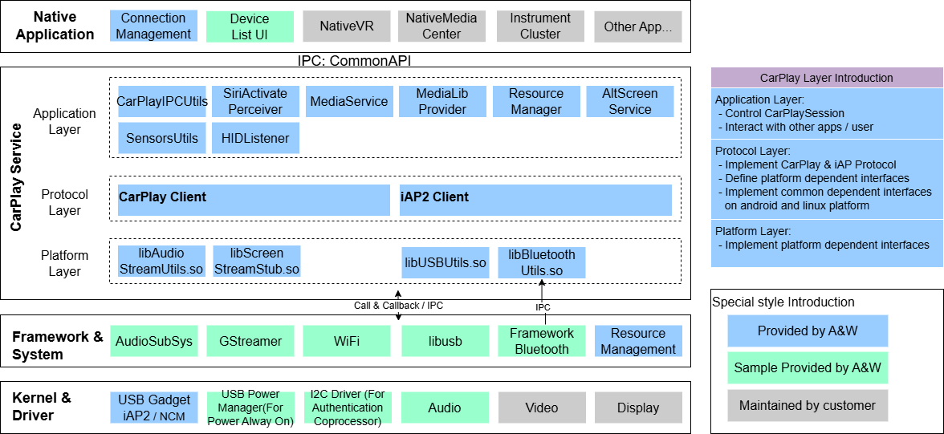
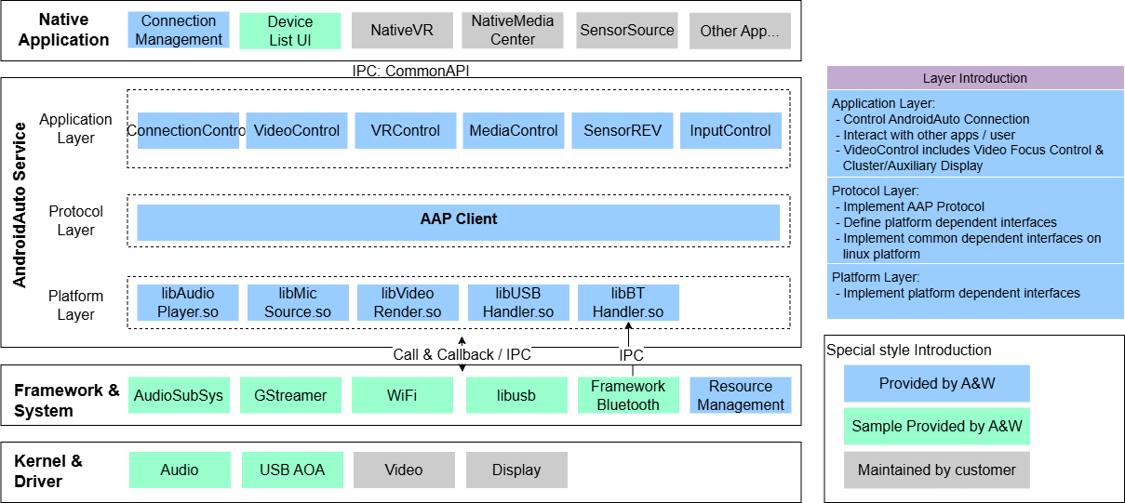
Nippon Seiki BT Stack/ECNR/CP/AA Q&A (05/14)
A3:
[CarPlay Diagram] [Android Auto Diagram]

Slide 4
Nippon Seiki BT Stack/ECNR/CP/AA Q&A (05/14)
Q4: Check if A&W has experience developing 2-Wheel CP/AA products (Please provide specific examples.)
A4:
We started developing 2-Wheel solution with ST about 5 years ago, and we've also been collaborating with Telechips, NXP, and ARK for customers in India, Southeast Asia, China, Taiwan, and the EU .
Q5: If A&W has experience developing 2-Wheel CP/AA products, then What kind of ITU-T Experience with TEST support
A5:
A&W has extensive experience with CarPlay ITU-T certification for 4W products, as well as 2W products.
Moreover, utilizing our in-house ITU-T testing tool, we can verify audio quality and optimize to reduce RTD efficiently. We can also carry out pre-Test for CP/AA, ITU-T prior to the real test.
Q6: Introduction of NR adoption examples in 2-Wheel CP/AA products (Please provide specific examples.)
(For example, implementing NR in the handset, but not ECNR in the cluster, etc.)
A6:
Our ECNR has extensive experience in 4W . A&W also has Noise Reduction and Neural NR technologies for open space processing.
Also most 2W customers have discussed the application of NR with us. If it is to solve the problem of noisy speech transmission through headphones on helmets, the situation may be different because there are many types of helmet headphones. Currently, no products with NR function have been released yet.

Slide 5
Nippon Seiki BT Stack/ECNR/CP/AA Q&A (05/14)
Q7: Please list the strong advantages of adopting A&W's 2-Wheel CP/AA solution.
A7:
1. Strong Support for Cluster Development : validation and integration
- Bluetooth : Mfi iPA2, EIR , Out of band
- Support for Round Trip Delay, Signal Noise Ratio, Jitter, WiFi Throughput/ interference optimization
- Flexible customization for 2-wheel CPAA display layouts, resolutions, and UI/HMI requirements
2. Smooth Collaboration with SI Partners
- Designed for hook-and-go integration with existing SI architecture and workflow
- Support for CP/AA connection management, and resource coordination
- Helps streamline bring-up, debugging, and overall integration efficiency
3. ITU-T Test
- Maintains in-house self-developed ITU-T testing tools, audio tuning, and issue analysis flows (e.g. leading zero,
max zero, audio distortion, clipping...), helping accelerate fine-tuning on customer platforms.
- Hands-on experience participating in ITU-T validation and audio tuning in certification labs
4. Ready for Certification

Slide 6
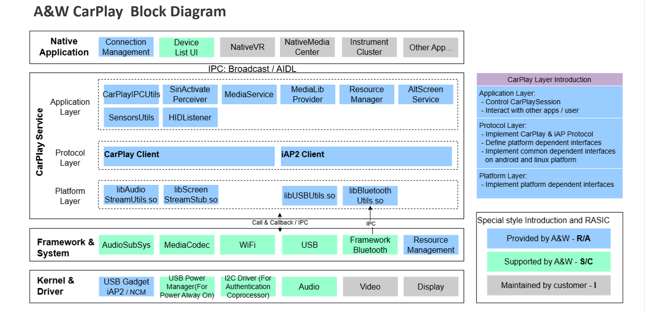
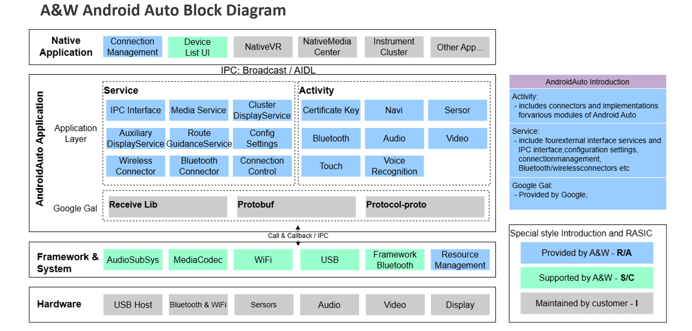
Nippon Seiki BT Stack/ECNR/CP/AA Q&A (05/14)
Regarding the descriptions in the following two figures:
Q8: In the two diagrams above, is it correct to understand that blue represents what A&W provides (warranties), green represents what A&W can support but without warranty, and gray represents what the customer develops and guarantees?
A8: Yes
Q9: In the CarPlay block diagram, Apple typically provides the client.
However, is it correct to understand this diagram as meaning that A&W provides with Apple client? Please explain if there is a misunderstanding.
A9: A&W is the licensee for Apple CarPlay, and we can obtain CarPlay development documents and libraries.
For certification , Nippon Seiki or their motocycle maker need an Apple account to apply for certification with Apple.
Q10: In the Android Auto block diagram, should Google Gal be obtained from A&W or Nippon Seiki?
A10: Google Gal requires Nippon Seiki or motorcycle maker to provide it.

Slide 7
Nippon Seiki BT Stack/ECNR/CP/AA Q&A (05/14)
Q11: Kondo-san wants assurance that A&W can truly handle various specification changes/additions and support for problems with just the development cost.
A11:
A&W's business model primarily uses a per-copy license, and there are no additional fees , we also accept specification changes during the project's progress without extra charge .

