Slide 1
Roadmap
 | 2025 Q4 | 2026 Q1 | 2026 Q2 | 2026 Q3 | 2026 Q4 | 2027
Bluetooth Stack V6.x
Channel Sounding
Bluetooth
LE Audio : HAP / HAS / LC3 plus
Bluetooth Stack V˙7.0:
HDT ( 7.5Mbps), HBLE
BLE Profile : MESH 1.1 with NCL / PAwR /ESL/ EAD
Smallest Footprint / CPU loading for Consumer product : Camera, Printer, Mic, Speaker, Controller…

Slide 2
Roadmap
 | 2025 Q4 | 2026 Q1 | 2026 Q2 | 2026 Q3 | 2026 Q4 | 2027
Audio : Wind Noise Reduction / Environment Noise Cancellation / Acoustic fingerprint
P.1140 eCall
Audio / Voice
AI NR : DNN NR
Voice :Keyword Recognition / VR
Wi-Fi
WiFi CPD
Ethernet
Ethernet AVB :Talker/Listener
Mirroring
CarPlay R19 /CarPlay Ultra

Slide 3
2W User Case

Slide 4




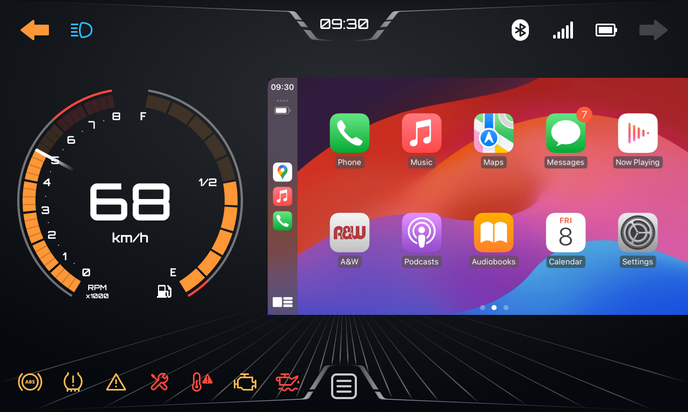

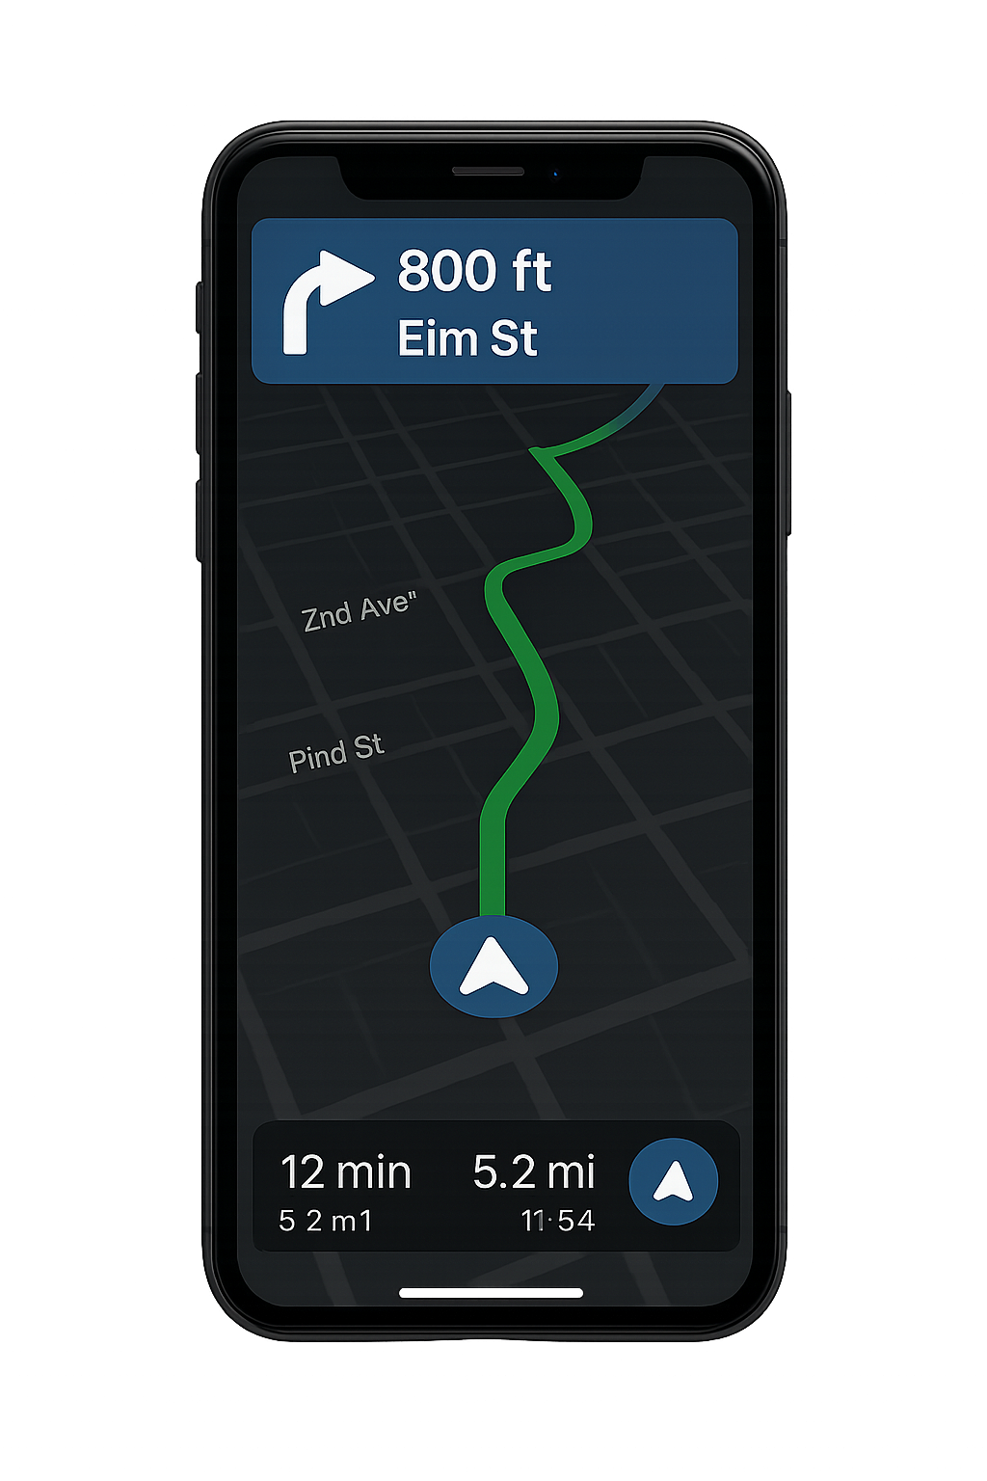



Features
PhoneLink Mirroring
CarPlay
Android Auto
Miracast
Bridge with Bluetooth
A&W 2-Wheeler HMI
CarPlay
Keyless Access
Wi-Fi
USB
Android
Auto
Map Mirroring (Turn-By-Turn )
Stream still image snapshots from the MAP via GATT/SPP
Support various MAP
TPMS
(Tire-pressure monitoring system)
Bluetooth
Handsfree call on Helmet Headset
Intercom between driver and passenger
Music sharing
Voice Recognition

Slide 5




2Wheeler Digital Cluster
Voice Triger, Offline VR
Answer the call
A2DP Audio Wrapper
Audio Driver
A2DP
Voice Command
HFP Audio Wrapper
Bluetooth
Incoming call
Voice Trigger
& Offline VR
ATA (ANSWER)
A2DP
When an incoming call arrives, Driver can answer the call without touching or pressing any buttons. Voice Trigger is always awaiting and actives the offline VR when a Wake-Up word is said.

Slide 6
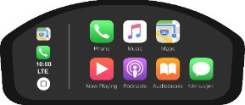

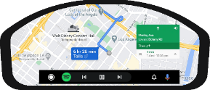

PhoneLink Mirroring
Along with BT audio Bridge, CarPlay and Android Auto are supported.
Provide iAP2 / OOB / Authentication for CarPlay connection
Performance & Latency tuning
Maintenance and support for product lifetime.
Provide Pre-Test for CarPlay Certification
Support for Certification with partner 3rd party test labs
Wi-Fi
Wi-Fi
USB
USB
HFP
Android
Auto
CarPlay
A2DP
HFP
A2DP
HFP
A2DP

Slide 7
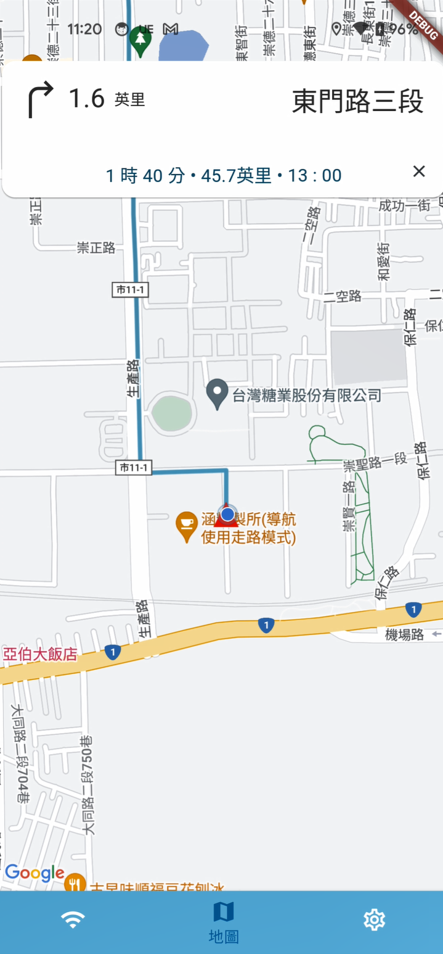
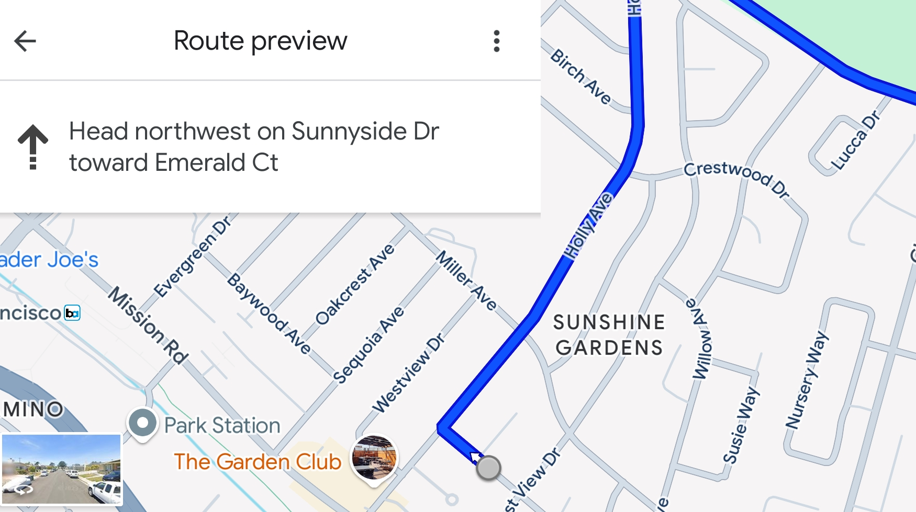
Map Mirroring for Turn-By-Turn
A&W supports map screen capture and image streaming from smartphones to 2W Cluster. It is designed to work with various map applications, including Google Maps, HERE, and others, providing flexibility and compatibility across navigation platforms.
GATT/SPP
Transport | Resolution | Frame Rate
BLE GATT | 480×272 JPEG | 2–5 FPS
Bluetooth SPP | 480×272 JPEG | 5–8 FPS
Wi-Fi P2P | 480×272 JPEG | 10–15 FPS
or
Wi-Fi

Slide 8


1xBT chip
Since the motorcycle doesn’t have a built-in speaker, voice and music must be streamed to the helmet headset, which requires an additional SCO or A2DP streaming.
A&W has extensive experience in multi-streaming use cases and can effectively manage latency, compatibility, and hardware constraints (e.g., BT chip capability, PCM/UART spec, etc.)
Multi SCO & A2DP and Audio routing
A&W PhoneLink
A&W PhoneLink
HFP
BT/Wi-Fi Chip
BT/Wi-Fi Chip
A2DP
Driver’s Phone
HFP 1
HFP 2
HFP
A2DP
Driver’s
Helmet
Passenger’s
Helmet
Driver’s
Helmet
USE CASE:
HFP call on the Driver’s Helmet(2SCO)
A2DP audio streamed to Driver’s Helmet (1SRC + 1SNK)
USE CASE:
Intercom between Driver and Passenger

Slide 9

1xBT chip
Use Case: Intercom
Audio Bridge
Audio Bridge
Incoming Call
SoC/MCU
SoC/MCU
HFP
BT Chip
HFP
BT Chip
HFP AG_1
HFP AG_2
SCO_3
HFP AG_1
HFP AG_2
SCO_1
SCO_2
SCO_1
SCO_2
SCO_1 and SCO_2 are connected.
Driver and Passenger are able to communicate using Intercom
During the Intercom, if there is a call on the Phone
H/U disconnect SCO_2 and switches to SCO_3. The Driver can have a call on the Headset

Slide 10
2xBT Chips
Two Helmets with Two BT/Wi-Fi chips
USE CASE:
Respective HFP calls on Driver’s and Passenger’s Helmets at the same time
A2DP audio concurrently steamed to both Driver’s and Passenger’s Helmets (1SRC + 2SNK)
Intercom between Driver and Passenger
Conference call with Driver and Passenger
Note: WBS depends on BT chip, Two BT/Wi-Fi chips support must consider h/w limitation
A&W PhoneLink
BT/Wi-Fi Chip 1
BT/Wi-Fi Chip 2
HFP 1
A2DP 1
HFP 1
A2DP 1
HFP 2
A2DP 2
HFP 1
A2DP 1
Driver’s
Helmet
Passenger’s
Phone
Passenger’s
Helmet
Driver’s
Phone

Slide 11


2xBT Chips
Use Case: Intercom
SoC/MCU
SoC/MCU
SCO_3
BT Chip_1
BT Chip_2
SCO_3
BT Chip_1
BT Chip_2
SCO_4
SCO_4
SCO_1
SCO_2
SCO_1
SCO_2
1. Driver and Passenger have a HFP call respectively
2. Intercom between Driver and Passenger
SoC/MCU
SCO_3
BT Chip_1
BT Chip_2
SCO_4
SCO_1
SCO_2
3. Conference call with Driver and Passenger

Slide 12
LE Audio + Classic Simultaneous Connection for Camera
Digital Cluster
(Host Device)
LE Audio 1
(CIS)
LE Audio 2
(CIS)
BLE Audio 1
BLE Audio 2

