Slide 1
Technical Proposal
In the 2W cluster segment, demand for Bluetooth functionality is growing rapidly. However, a complete-type BT module can’t meet these demands, as its functionality is limited. At the same time, its BOM cost is much higher than the HCI type, where A&W delivers more robust and advanced features.
In resource-limited systems such as the TRAVEO MCU, we can reduce the memory footprint while providing advanced features, such as simultaneously connecting a phone and a headset to the 2W DC and streaming voice and A2DP audio.
Here, we are offering technical proposals for MCU and SoC platforms based on HCI-type BT and combo modules.

Slide 2
Block Diagram of Bluetooth complete module and HCI module
SoC/MCU
SoC/MCU
2W Digital Cluster
Application
2W Digital Cluster
Application
Bluetooth Application
Bluetooth Application
Bluetooth stack/profile
UART/USB
UART
Complete Type
Module
Bluetooth Baseband/ Radio
Bluetooth HCI type
module
MCU
RAM/ROM
HCI
Audio Interface:
I2S/PCM
Bluetooth stack/profile
BLE/BR/EDR
Audio DSP
Audio
Audio
HCI
Bluetooth Baseband/Radio

Slide 3
Features
Low End 2W Digital Cluster RTOS Solution
    A&W Solution with Bluetooth only HCI Type Chip
    Bluetooth Audio Routing : Connect Mobile Phone and Headset same time
      HFP AG & Client with Audio Bridge between Phone and Headset
      Stream Map guidance routed from Phone to Headset.
      A2DP SRC & SNK with Audio Bridge between Phone and Headset
      Bluetooth GATT : Turn-by-Turn data transfer .
    Bluetooth BLE (GATT) :
      Turn by Turn data transfer
    Map Streaming
      Bluetooth SPP : Stream Phone’s Map screen to Digital Cluster( Cluster need add MFI chip for iPhone )
    Memory Footprint
Bluetooth Memory Footprint
Item | Code Size | RAM Size | CPU Loading
BT Stack/BLE | 150KB | 32KB | Negligible
Audio Routing : 1.HFP 2.A2DP |  |  | 30MHz
Map Streaming |  |  | Negligible
Total | 150KB | 32KB | 30MHz

Slide 4
Features
Middle /High End 2W Digital Cluster Solution
    A&W Solution with Bluetooth Combo Chip
    Bluetooth Audio Routing : Connect Mobile Phone and Headset same time
      HFP AG & Client with Audio Bridge between Phone and Headset
      Stream Map guidance routed from Phone to Headset.
      A2DP SRC & SNK with Audio Bridge between Phone and Headset
      PBAP
    Bluetooth BLE :
      Turn by Turn data transfer
      TPMS …
    Phone Mirroring
      CarPlay Wired & Wireless with Audio bridge between Phone and Headset
      Android Auto Wired & Wireless with Audio bridge between Phone and Headset
    Map Streaming through Wi-Fi
      Stream Phone’s Map screen to Digital Cluster

Slide 5
Introducing A&W CarPlay/Android Auto Solution
A&W CarPlay/Android Auto Solution
End-to-End System-Oriented Design & Service:
- expedite development & ease certification process
  1. CarPlay & Android Auto SDK
      Connection Management: Authentication ( OOB, iAP2, MFi), Connection, Reconnection,
      Switching between Muti devices and Mirroring AP ( CP, AA…)
      Resource Management: Audio Focus / Mixing / Ducking Policy, Last User Mode: Native UI , CarPlay UI
      Solve User Input, UI Stream, Local GPS / GNSS (Blind guidance , Dead-Reckoning)
  2. Audio System:
      Driver : WiFi ( Throughput , Interference ,None DFS (Dynamic Frequency Selection) ),
      USB: Smart OTG (Role switch , Charging , USB Power Management)
      - System Configuration : Resampling, Jitter Buffer, Scheduling / Priority
      System Optimization : Fast Path , low Latency, RTD, Fast Cold Boot Connection
  3. Audio Quality
      ITU-T: Assist with resolving system-level problems (Bulk Delay, Sample Rate Mismatch, microphone sound dropouts…)
      Siri Speech Output Quality: Improves accuracy of speech recognition ( AEC, Leading Zero, Max Zero )
      ECNR / AEC : Provided by A&W : Auto Tuning Tool : Preemptively resolve software integration issues at an early stage

Slide 6
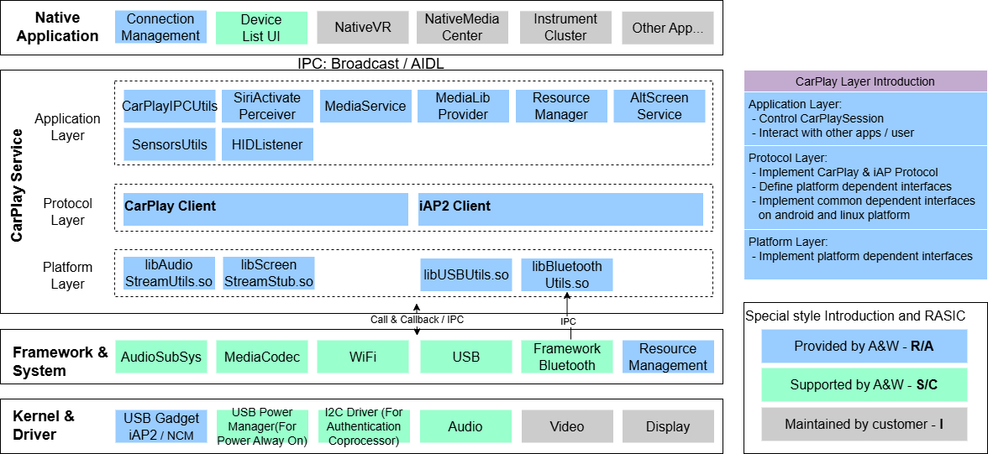
A&W CarPlay Block Diagram
Introducing A&W CarPlay/Android Auto Solution

Slide 7
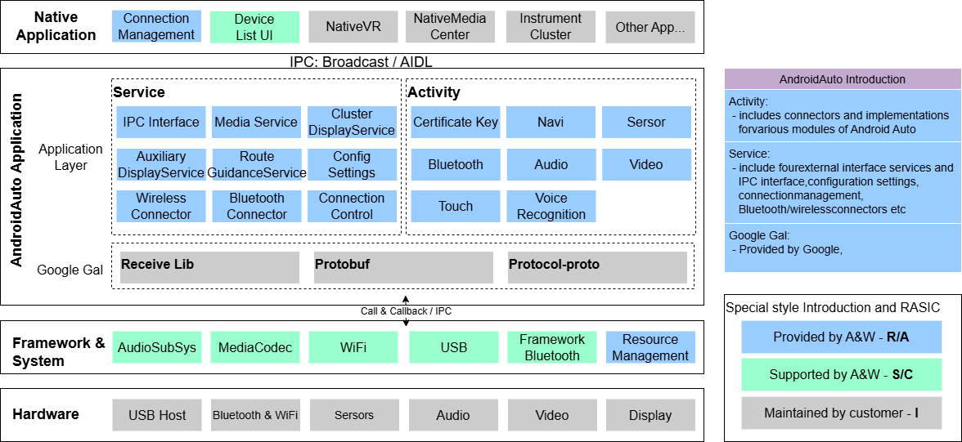
A&W Android Auto Block Diagram
Introducing A&W CarPlay/Android Auto Solution

Slide 8
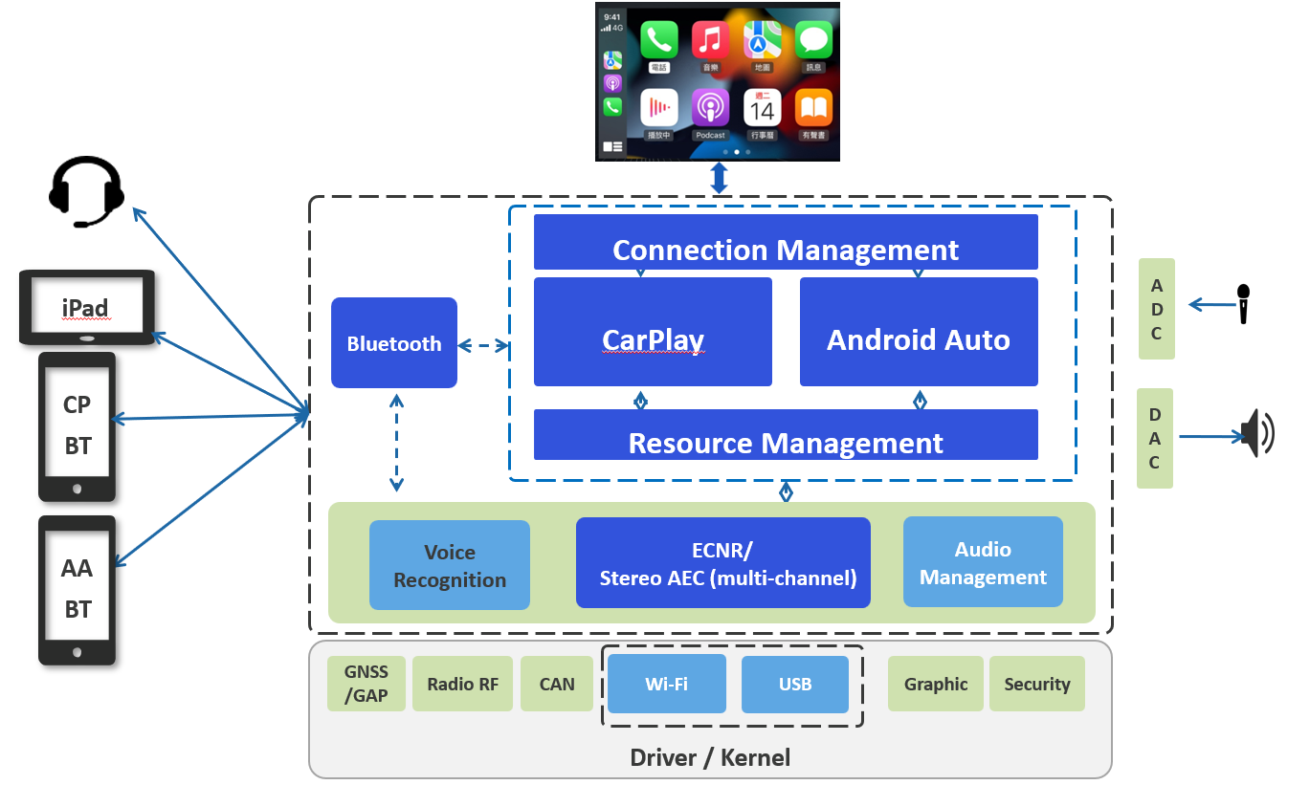
Introducing A&W CarPlay/Android Auto Solution
A&W PhoneLink Group Solution Diagram

