Slide 1
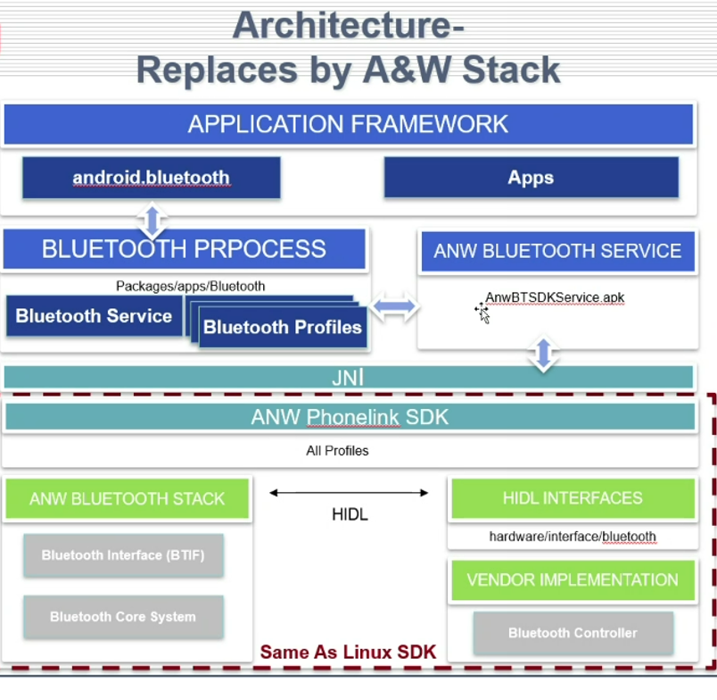
FCE Q&A
1. Architecture ( for Android System )
1-1 A&W Bluetooth ( for Android Compliant )

Slide 2
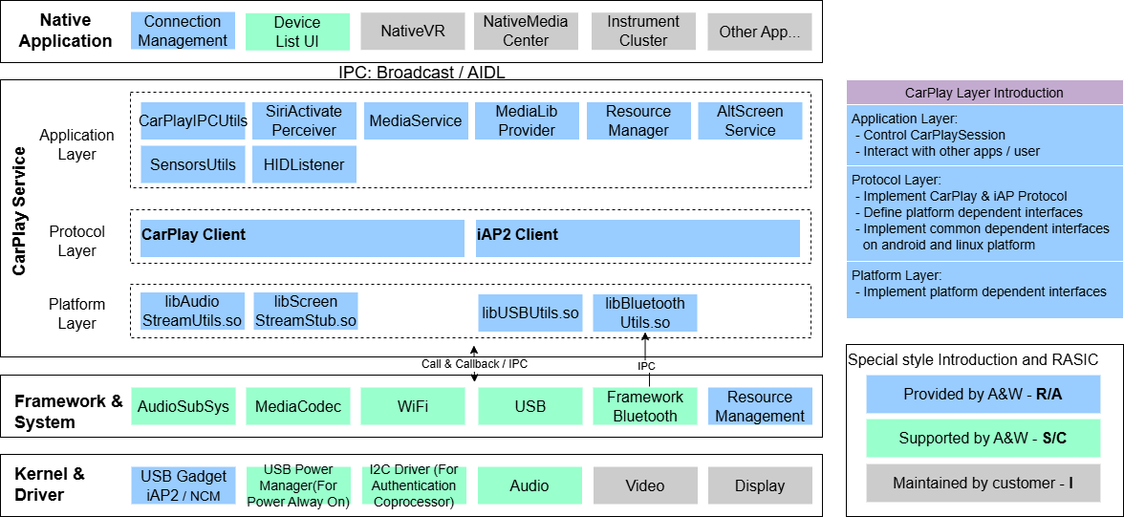
FCE Q&A
1-2 A&W CarPlay

Slide 3
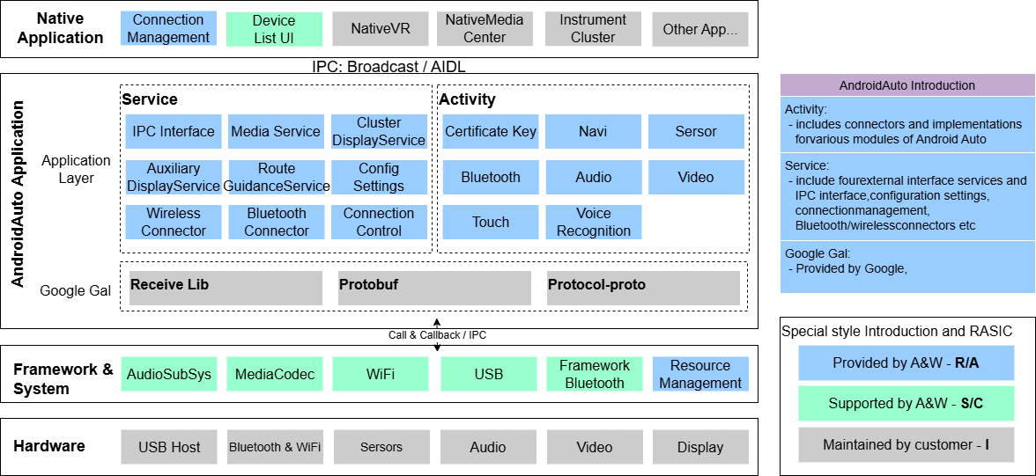
FCE Q&A
1-2 A&W Android Auto

Slide 4
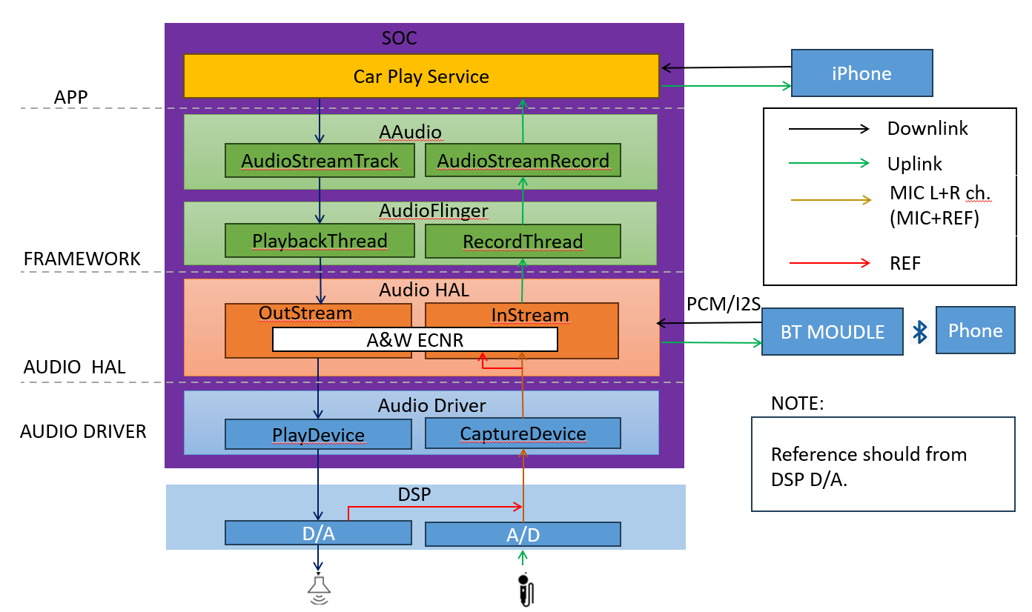
FCE Q&A
1-3 A&W ECNR

Slide 5
FCE Q&A
2. A&W Responsibilities
Refer to “A&W Responsibility_20260506.xlsx” for Bluetooth, CarPlay, Android Auto, and SW ECNR.

Slide 6
FCE Q&A
3. A&W Milestone
3-1 A&W Bluetooth :
  Evaluation & Integration ( 1–2 months)
    SDK trial on EVB / target SoC, basic BT testing.
    Installing A&W BT/ECNR SDK
    Modify Android's "Bluetooth Process" to using the A&W BT SDK service.
  Certification & SOP (1–2 months)
    Full system testing and production readiness.
    IOP Testing
    BQB Qualification

Slide 7
FCE Q&A
3-2 A&W CarPlay , Android Auto :
  System Check ( 1 ~ 2 months )
    Check List : the system's software and hardware dependencies ( Ready )
    Modify and Configure Connection Management , Resource Management
    SDK run on EVB / target SoC, basic testing
    Implementation of private specifications
  Pre-Testing : ( 2 ~ 3 months )
    Facet , PCTS
  Certification ( 4 ~ 6 months )
    USB / WiFi Performance, Location, Audio Quality(Siri, eSiri, ITU-T), Facet, In-Vehicle...

Slide 8
FCE Q&A
3-3 A&W ECNR :
ECNR lib delivery
  1 week after requirements and toolchain received
User scenario test tuning
  ~ 1 week
ITU-T/CarPlay test tuning
  Roughly 3~5 workdays for tuning one mode
  A typical CarPlay tuning session includes BT 2 modes, CP wired 3 modes, CP wireless 3 modes, and Siri 2 mode

Slide 9
Bluetooth SDK
A&W Solution Development Process and Service
Beginning Developing Integration SOP
RFQ
POC
System BT Chip Advanced
……
…
IOP
Security
Certification
Others
Advanced:
LE Audio
Multi-Connection
Auto-Parking
Audio Routing
SOC with 2 or 3 BT Chips
….
ACC ON / OFF Flow
UART Baudrate
Audio Driver
PCM Driver
Multi-Slot
HW Reset
….
Capability &
Limitation
Max Connection
2 / 3 SCOs
2 A2DP
Streaming
Classic + BLE +
LE Audio
…
Audio Routing
(HFP/A2DP)
A2DP(SRC)+LE Audio(CIS:SINK)
Classic + BLE + LE Audio
Rear Seat Entertainment
One Soc with
2 or 3 BT Chips
Mobiles
(Over 3700)
Headset
(Different Brands )
3rd Player
(Spotify, KKBOX, QQ…)
BQB: PTS
BT Application
CarPlay
(OOB, EIR , iAP2..)
ECNR
Small Code /RAM when needed
Defensics
Coverity
CVE
KNOB,
BIAS,
BlueBorne,
SweynTooth,
BlueFrag

Slide 10
CarPlay/Android Auto SDK
A&W Solution Development Process and Service
Beginning Developing Integration SOP
RFQ
POC
System Combo Chip
……
…
IOP
Certification
Others
Check List
HeadUnit 3rd Party APP:
WeChat,Player…
Connection Manager
CP / AA / HiCar…
Resource Manager
Advanced:
Audio Routing
….
HID, GNSS,
USB Device Mode,
WiFi AP, NCM Driver
BT OOB, iAP2 MFi, Display,
Audio System
ECNR:
Mic Variation,
Round Trip Delay
Stereo AEC
VR
Capability &
Limitation
BT / WiFi
Performance
Interference
Different Phone model / OS version,
VR
Different accents
System Optimization:
Connection speed
Latency
Test Item:
Location Drive Test,
Enhance Siri Test,
Facet Pre-Test..
PCTS Pre-Test
SW ECNR
Increase VR Recognition Rate
ITU-T Telephony
Audio Quality Test,
VR
Notes:
This is flow of development for Bluetooth. Explain each by each.

Slide 11
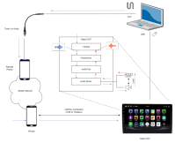
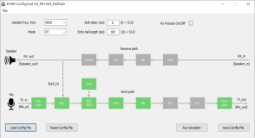
SW ECNR
A&W Solution Development Process and Service
Beginning Developing Integration SOP
RFQ
System Check
……
…
IOP
Tuning
Certification
Others
EC :
Mono/ Stereo
NR:
Engine / Road Wind / Rain/
Air Condition…
Advanced:
Multi-Mics
Voice Enhancement
….
Audio Path
Mic
Max input Level
Clipping/Saturation
Speaker
Non-linear , Distortion
ADC/DAC
Odd /Even
Harmonics
….
Car Speed
(0, 60, 100, ..)
Noise
Passenger Vice,
Engine,
Window,
Sunroof,
…..
Tunning Tool
Off-Line Tuning
ITU-T
P1100, P1110, P1120
Small
Code/ RAM CPU Loading
VR
Siri / Google Assistant
Alexa

