Slide 1
Introducing A&W CarPlay/Android Auto Solution
A&W CarPlay/Android Auto Solution
End-to-End System-Oriented Design & Service:
- expedite development & ease certification process
  1. CarPlay & Android Auto SDK
      Connection Management: Authentication ( OOB, iAP2, MFi), Connection, Reconnection,
      Switching between Muti devices and Mirroring AP ( CP, AA…)
      Resource Management: Audio Focus / Mixing / Ducking Policy, Last User Mode: Native UI , CarPlay UI
      Solve User Input, UI Stream, Local GPS / GNSS (Blind guidance , Dead-Reckoning)
  2. Audio System:
      Driver : WiFi ( Throughput , Interference ,None DFS (Dynamic Frequency Selection) ),
      USB: Smart OTG (Role switch , Charging , USB Power Management)
      - System Configuration : Resampling, Jitter Buffer, Scheduling / Priority
      System Optimization : Fast Path , low Latency, RTD, Fast Cold Boot Connection
  3. Audio Quality
      ITU-T: Assist with resolving system-level problems (Bulk Delay, Sample Rate Mismatch, microphone sound dropouts…)
      Siri Speech Output Quality: Improves accuracy of speech recognition ( AEC, Leading Zero, Max Zero )
      ECNR / AEC : Provided by A&W : Auto Tuning Tool : Preemptively resolve software integration issues at an early stage

Slide 2
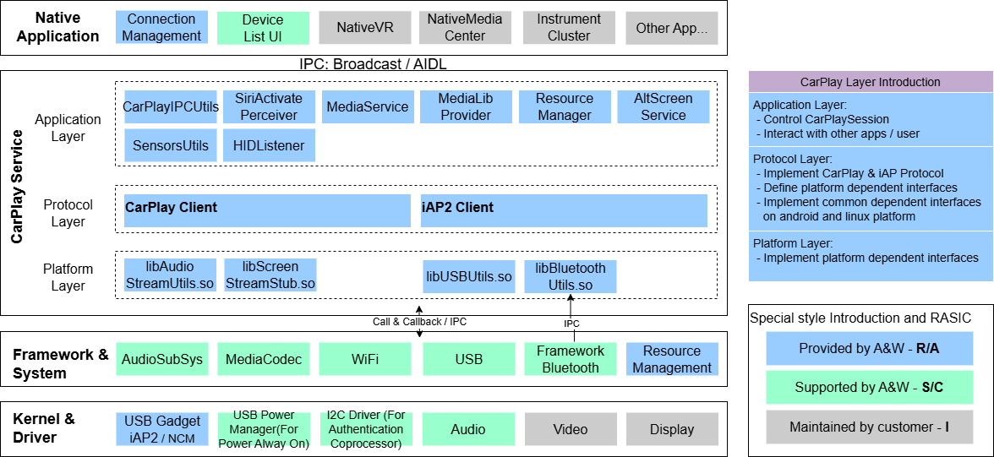
A&W CarPlay Block Diagram
Introducing A&W CarPlay/Android Auto Solution

Slide 3
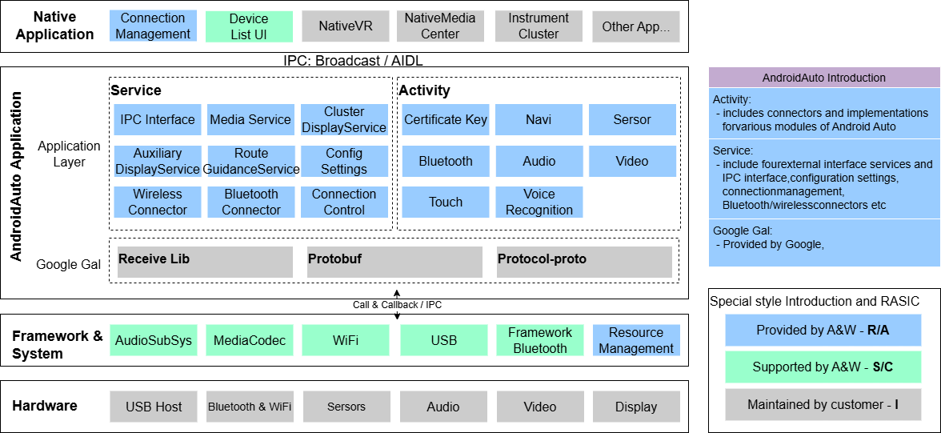
A&W Android Auto Block Diagram
Introducing A&W CarPlay/Android Auto Solution

Slide 4
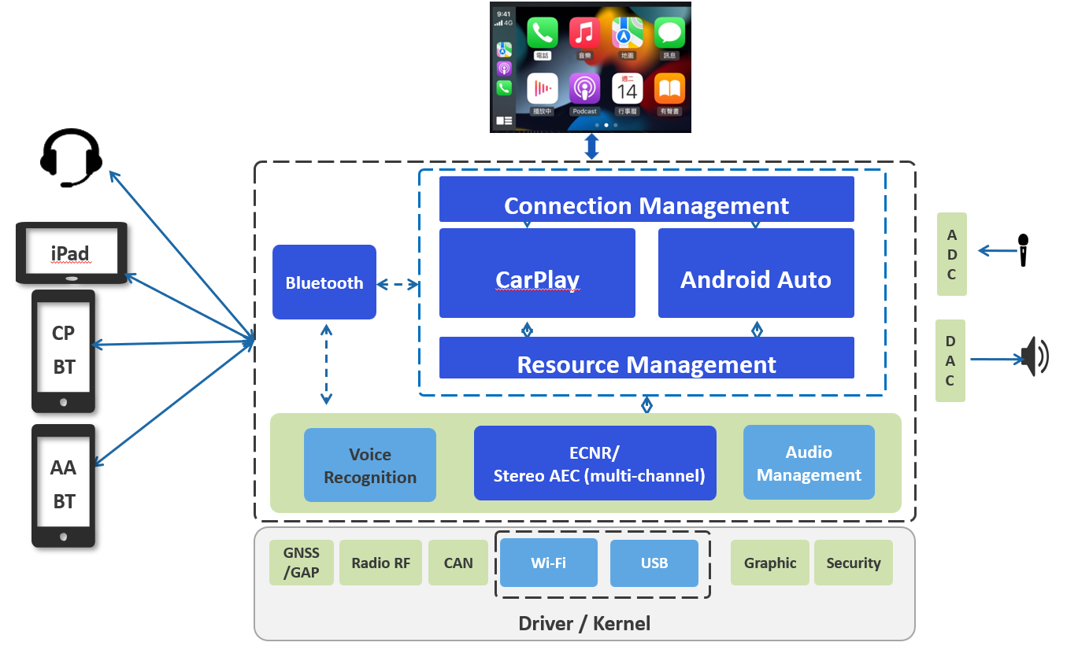
Introducing A&W CarPlay/Android Auto Solution
A&W PhoneLink Group Solution Diagram

Slide 5
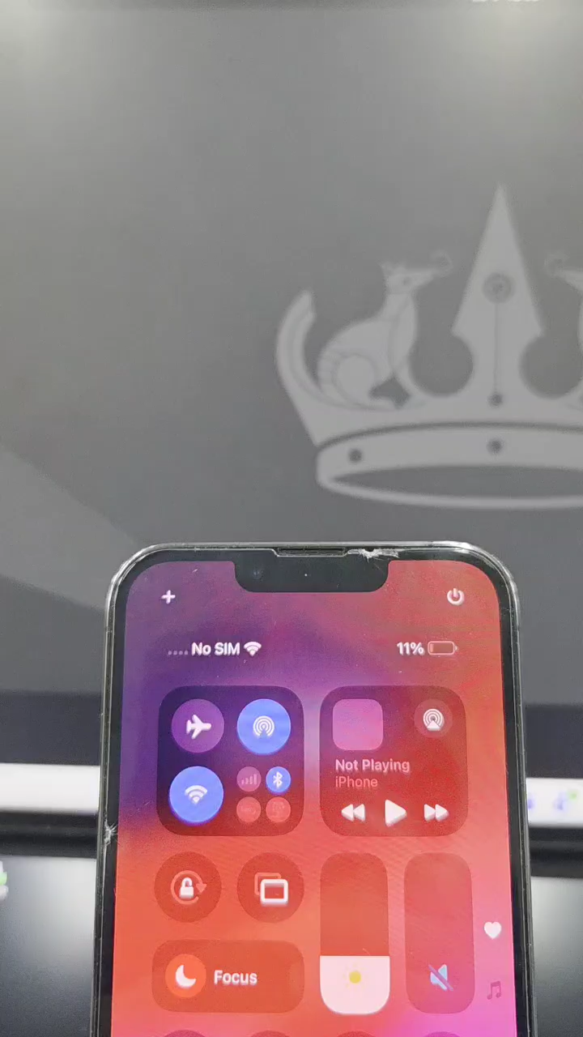
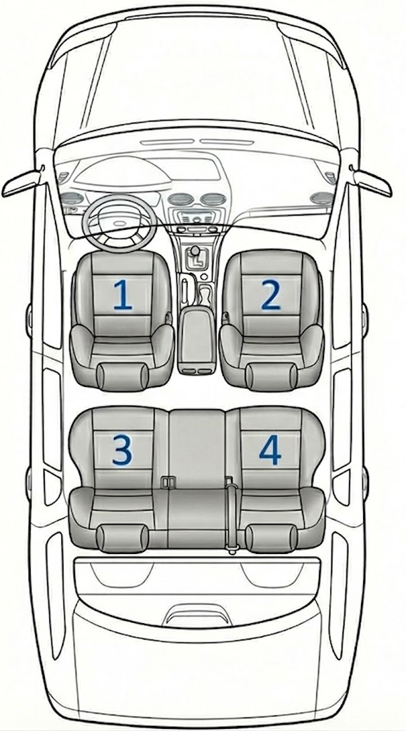
JKC A&W CP/AA Technical Roadmap Q&A (03/27)
Questions about A&W CP/AA Technical Roadmap for JKC
Q1: Could you give us an overview of the video streaming feature A&W is developing for Apple AirPlay?
A1: The AirPlay Video Specification for CarPlay Plugin R19 has not been released yet.
As attached file, AnW’s AirPlay Server is discoverable; iPhones can now connect and
initiate screen mirroring or streaming to the PC.
Q2: Regarding "Voice Bubble," could you please explain its development background, technical details, and provide examples of in-car applications?
A2: In-cabin area is divided into several regions (bubbles).
Speech from other ‘bubbles’ will not be recorded by the microphone of that specific region.
For example, driver at region 1 is talking on the phone, while region 4passenger is talking to
another passenger simultaneously.
Microphone at region 1 will collect only driver’s voice and send it to the far-end side party.
This will ensure each region’s communication quality.
DSP techniques and DNN processing are used to achieve this.

Slide 6
JKC A&W CP/AA Technical Roadmap Q&A (03/27)
Questions about A&W CP/AA Technical Roadmap for JKC
Q3: Regarding "Special Audio," could you please explain its development background and any features other than Dolby Atmos?
A3: This feature requires an upgrade to CarPlay Plugin R18.1, which has been completed.
A proof of concept (PoC) has been internally validated for 5.1-channel audio data transmission and decoding.
The exported 5.1-channel PCM audio plays back successfully.
Q4: Regarding "Voice Separation," could you please explain its development background, technical details, and provide examples of in-car applications?
A4: When a microphone receives several voices simultaneously, this technology can separate each voice so they will not interfere with each other.
This is the base technology of other technology like “Voice Bubble”.

Slide 7
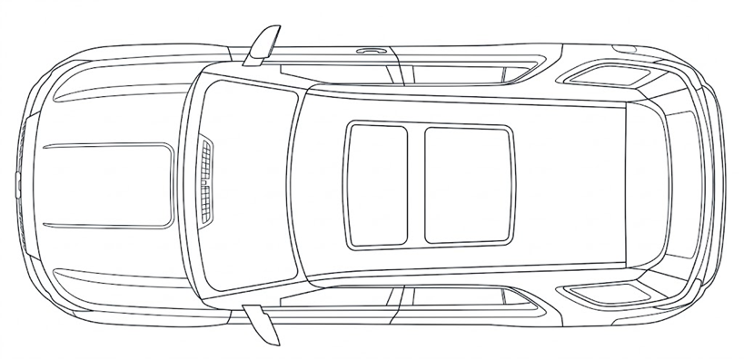


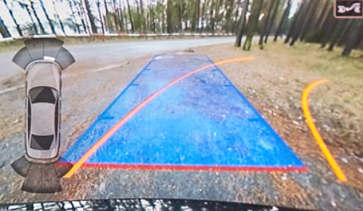
JKC A&W CP/AA Technical Roadmap Q&A (03/27)
Questions about A&W CP/AA Technical Roadmap for JKC
Q5: Regarding "Ethernet AVB" could you please explain its development background, technical details, and provide examples of in-car applications?
A5: AVB is used to replace proprietary heavy wiring while upgrading standard Ethernet from best-effort to a Time-Sensitive Network.
It supports the high-bandwidth data required for modern Cockpit and ADAS architectures.
AVB is a collection of IEEE 802.1 standards—such as 802.1AS, 802.1Qat, and 802.1Qav—plus the IEEE 1722 transport protocol.
As illustrated in the sample architecture, Ethernet AVB facilitates a distributed, scalable network that supports real-time audio and video streaming; it also leverages a ring topology to ensure path redundancy for system robustness.
Bridge
HU
Bridge
Bridge

Slide 8
JKC A&W CP/AA Technical Roadmap Q&A (03/27)
Questions about A&W CP/AA Technical Roadmap for JKC
Q6: Regarding “CarPlay Ultra" could you please explain its development background, technical details, and provide examples of in-car applications?
A6: We are looking for a platform suitable for PoC (Proof of Concept) validation, which must address dependencies across the following layers:
Hardware and Connectivity Layer
MFi Certification: It is required to obtain Apple’s MFi authorization and the corresponding protocol stack code (Accessory SDK).
High-performance wireless connectivity: CarPlay Ultra essentially requires Wi-Fi 6 (802.11ax) and Bluetooth 5.x. Low latency is the top priority.
Multi-display interfaces: The EVB (Evaluation Board) must support multiple video outputs (e.g., LVDS, MIPI-DSI, or HDMI) to simulate multiple physical screens such as the instrument cluster and central display.
System Architecture Layer
Multi-screen rendering capability: A powerful compositor is required, capable of handling H.264/H.265 video streams from the mobile device and accurately distributing them across different display regions.
Low-latency video decoding: The hardware decoder (VPU) must support ultra-low-latency multi-stream concurrent decoding.
Vehicle Data Layer
CAN / Ethernet signal mapping: Unlike previous versions, the Ultra version requires access to real-time vehicle signals such as speed, battery/fuel level, coolant temperature, and tire pressure. During the PoC stage, these data must be converted via a simulator or real gateway into Apple’s required Vehicle Signal Specification (VSS) format.
Bi-directional control interface: It must support reverse control from the CarPlay UI to hardware functions such as air conditioning, seats, radio, etc.
Q7: Could you please describe the royalty image of A&W's total solution (CP/AA, ECNR, BT stack)?
A7: The royalty image is less than US$1.5

