Slide 1
JKC A&W Echo Cancellation Q&A (01/09)
Questions about A&W Echo Cancellation for JKC(Ishibashi-san)
Q1: Has A&W commercialized an EC that runs on the ARM A53 Core?
If so, when can you provide a sample to JKC at the earliest?
A1: Yes, it is available on different ARM platforms. A working library can be provided 1 or 2 days later after the toolchain is received by A&W.
Q2: JKC would like to know the sampling frequencies at which A&W EC operates and any limitations.
A2: A&W ECNR lib supports 8/16/24/32/48kHz sampling rates.

Slide 2
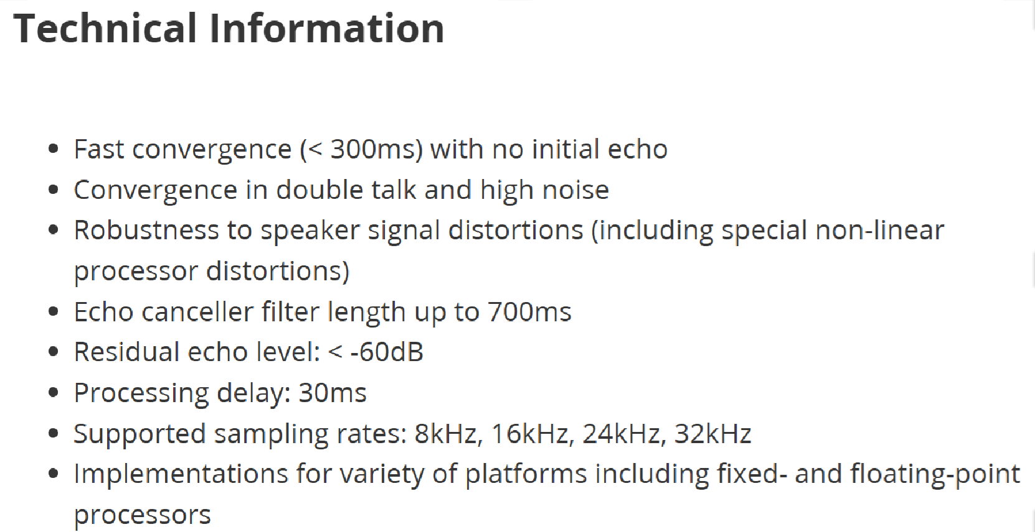
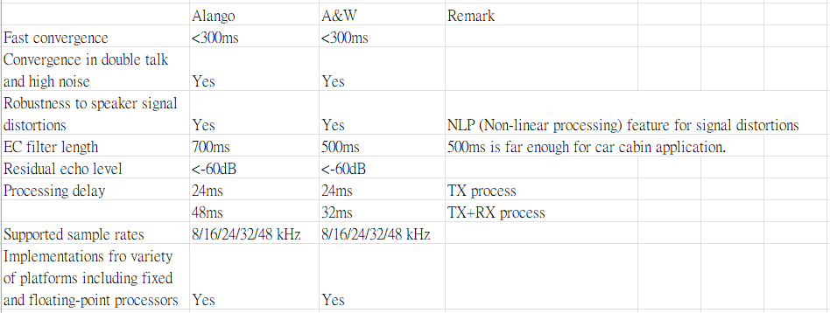
JKC A&W Echo Cancellation Q&A (01/09)
Q3: In order to compare the performance of Alango EC and A&W EC, JKC would like to see the performance of A&W EC listed in the same categories as Alango EC below.
A3:

Slide 3
JKC A&W Echo Cancellation Q&A (01/09)
Q4: JKC would like a quote for A&W EC royalty (82,170 units/6 years + overseas product development).
A4:
A&W : USD 0.22/pcs

