Slide 1
Nippon Seiki BT Stack/ECNR/CP/AA Q&A (12/11)
Questions about 2Wheel Solution for Nippon Seiki(Kondo-san)
Q1: Nippon Seiki would like to see an introduction, including a demo, of the solutions A&W offers for 2-wheel vehicles.
A1: https://drive.google.com/file/d/14vbV8ZsCErXliJPRSlubzHkqjLbW_hHK/view?usp=drive_link
Q2: Nippon Seiki does not have a royalty image for A&W's BT Stack or other solutions (ECNR/CP/AA), so we would like to know the royalty image for the expected quantity.
A2:
BT stack only : USD 0.3 /per pcs (HFP,A2DP routing ,Intercom)
BT stack +CarPlay : USD 0.65 /per pcs( + USD 0.25 for Android Auto)
ECNR : The ECNR price is around USD 0.4.
Q3: Nippon Seiki would like to compile a document with specific development examples and role assignments in order to explain the outline of A&W's solution and the division of hardware required during development internally.
A3:
Q4: Is it correct to say that Nippon Seiki will provide the H/W (board) to A&W, and A&W will provide a POC that runs on that board?
A4: If Nippon Seki request A&W takes care of all S/W parts, A&W can provide a full demo S/W if H/W, BSP, Toolchains are given.
 | 2 – 4 Weeks | Depending on the requirements and available resources on Customer | 1-2 weeks
Nippon Seiki | Provide H/W, BSP, Toolchains Verify H/W connection and Interface | Integrate 1st SDK with its Application
A&W | Port to the Target device 1st SDK release with major features | Complete the rest features Technical Support & bug fix | Test and verification

Slide 2
Nippon Seiki BT Stack/ECNR/CP/AA Q&A (12/11)
Q5: Nippon Seiki wanted to know about ECNR's specific track record and support for A&W's 2Wheel.
A5:Refer page 3
Q6: When Nippon Seiki develops a POC to promote to 2 Wheel Vendors, is it possible for A&W to cooperate in the POC development? (Do we have any past experience?) .
If so, will it be free or paid?
(However, even if A&W develop a POC, Nippon Seiki cannot guarantee that the OEM will adopt A&W's solution.)
A6: Yes, we can collaborate for a PoC without any NRE. We’ve been collaborating with NXP, Telechips, MediaTek, and ST for 2W. And some of collaboration has led to real projects.
Q7: Nippon Seiki would like to know what kind of SOC, MCU, and BT chips A&W has used and what kind of functions these chips have been equipped with.
A7: Refer to page 4.
Q8: Does A&W's CP/AA Solution include Wi-Fi connectivity? I would like to know the scope of support for A&W's CP/AA Solution from Nippon Seiki.
A8.A&W CP/AA support include Wire/Wireless Connectivity , Device Manager , Resource Manager .
Help to pass CP/AA certification
If need , A&W also can support to solve system issue , like USB , WiFi and Audio framework .

Slide 3
Nippon Seiki BT Stack/ECNR/CP/AA Q&A (12/11)
Q5: Nippon Seiki wanted to know about ECNR's specific track record and support for A&W's 2Wheel.
A5: Many customers at Automotive use A&W ECNR.
Currently, our 2Wheel customers in Japan, India, and China do not have ECNR requirements. Some manufacturers have discussed this need, but there are no actual application cases , if Nippon Seiki have some use case we can discuss together .
 | Customer | OS | Status
 | Japan A company | Linux | On Going
 | Japan J company | RTOS | Shipping
 | Japan P company | RTOS | Shipping
 | Venucia/xx | Android 10 | Shipping
 | Nissan | Android 13 | Shipping
ECNR | Luxgen/n7 | Android 13 | Shipping
 | Toyota/TAKUMI/TITAN | Linux 4.x | On Going
 | IRAN/xx | Android 12 | On Going
 | L/LM24 | Android 14 | On Going
 | Fortan/BRIA | Android 13 | Shipping
 | Geely | Android 11 | Shipping
 | Kaga Fei | Linux 5.15 | On Going

Slide 4
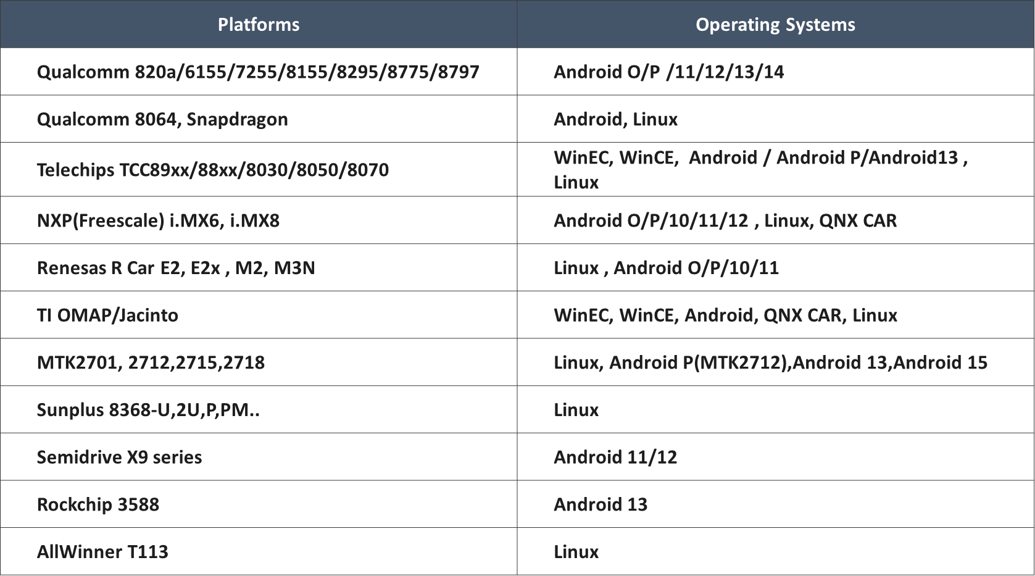
Nippon Seiki BT Stack/ECNR/CP/AA Q&A (12/11)
Q7: Nippon Seiki would like to know what kind of SOC, MCU, and BT chips A&W has used and what kind of functions these chips have been equipped with.
A7:
SoC Platform Experience (Bluetooth,ECNR , CarPlay,Android Auto)
Note : The Bluetooth functionality is the same across different platforms/OS; it is identical in both 4W and 2W products.

Slide 5
Nippon Seiki BT Stack/ECNR/CP/AA Q&A (12/11)
MCU Platform Experience (Bluetooth,ECNR )
Platforms | Operating Systems
Renesas 7269, 726A/726B | µITRON
STM32 MCU (M3/M7) | µCOSII
ST Accordo2 | eT-Kernel
ST Accordo5 | Linux, eT-Kernel
Panasonic CUBIT, GERDA | µITRON
NXP RT1170,1172 | FreeRTOS

Slide 6
Nippon Seiki BT Stack/ECNR/CP/AA Q&A (12/11)
Bluetooth Chip Experience
Brand | Type | Model No.
Qualcomm | BT+WiFi Chip | QCA6564A, QCA6574A, QCA6595 QCA6696,QCA6688, QCA6698…
Infineon | BT+WiFi Chip | 43353, 43455, 89335, 88335, 89359,89373,88373, 89570…
NXP | BT+WiFi Chip | 8787, 8887, 8987, 9098, AW690, AW611,AW693…
Realtek | BT+WiFi Chip | 8822ES,8821CS,8723DS,8733BS
MTK | BT+WiFi Chip | 6630, 7921..
Realtek | Bluetooth HCI Chip | 8761ATV
Infineon | Bluetooth HCI Chip | 20713, 89071/2
Note : The color in Blue mean support LE Audio Chip

Slide 7
Questionnaire
Q1. Are there any requirements from 2W vendors?
Q2. Does Nippon Seiki or Customers prefer any specific platform?
Q3. How much would the POC development cover—only BT, CP/AA connectivity functions, or a complete system including a mature application with CAN, ODD, etc.?

