Slide 1
YAMAHA Motor A&W Solution Q&A (10/29)
Questions about A&W Solution for YAMAHA Motor
Q1: YAMAHA understands that BT SIG certification is only required for the end product, but why is separate certification required for the BT H/W and Stack?
Also, please compare the BT Complete Module and the Stack + BT Chip, and explain who needs to undergo what kind of certification for each.
A1: Only listing from end product side is needed for both cases:
For HCI: providing DN/QDID of BT HCI Chip Controller & DN/QDID of A&W stack ( with profiles) to do listing
For complete type: providing DN/QDID of BT complete Chip to do listing
Q2: What type of contracts has A&W used in past development?
For example, is it a three-way contract between the OEM, Tier 1, and A&W?
Or is there a contract between Tier 1 (including SI) and A&W, and not a direct contract with the OEM?
A2: Basically, a contract is only needed with the paying company;
Not many, but sometimes, a three-way contract is required by end customer for service or NDA purpose.

Slide 2
YAMAHA Motor A&W Solution Q&A (10/29)
Q3: How A&W guarantees which mobile phones will be able to connect.
For example, regarding connectivity with unknown local mobile phones.
Q4: Oppo phones cannot connect because they do not comply with the BT specifications, and Oppo did not fix the problem, so Yamaha made changes to the Stack. Can A&W provide a similar solution?
Also, can the current Stack connect to Oppo phones?
Q5: YAMAHA don't think it's possible to ensure 100% coverage (connectivity) on Android smartphones, but I'd like to know if A&W has any coverage standards.
Q6: Does A&W Stack guarantee connectivity by evaluating the 3,700 mobile phones they own?
Or is the reason they own 3,700 mobile phones a stockpile in case a problem occurs?
A: Yes, IOP issue for varieties of mobile phones, headsets, 3rd parties app...is the biggest headache for BT connectivity.
A&W is likely the world‘s best BT stack provider in car industry, one of the main reasons is to provide the best/most complete IOP.
(Interoperability)
1. Own 3700 mobile phones in house, and lots of other devices including headsets, speakers, HID game controllers.
2. A&W IOP covers not only the above devices, but also 3rd- parties apps (e.g., QQ, WeChat, etc.),...
3. A complete Anti-hacker testing (by Defensics ) is also fully executed.
4. Many China brand phone phones exists IOP issues, including 3rd party-apps issues. A&W has been focusing these for many years,
including to provide analysis or possible workarounds. And already got good reputation at this aspect.
Some examples of brands: OPPO, HUAWEI, Lenovo, Meizu, Mi, Realme, Vivo, ZTE, and OnePlus
5. More compatibility issues come for LE audio, including BT chip limitation other than the above.
A&W is also ready to provide the best.

Slide 3
YAMAHA Motor A&W Solution Q&A (11/10)
Q7: At Yamaha, we recognize that when a defect such as an inability to connect to BLE is discovered in a product in the market,
analyzing the cause is a challenge.
Please tell us whether A&W offers any services related to cause analysis, and if so, what part of the process can A&W handle?
There are various possible causes, such as device-related, app-related, etc.
How can A&W isolate the problem and where can they begin their investigation?
For example, after the OEM has isolated the issue, the investigation may be limited to the communications aspect.
A7: A total system quality assurance is one of the major reasons to be the best compatibility and service
1. App (customer)-oriented : providing App level flow charts/command lines to communicate with customer for spec,
flow, use cases in development, and then spot and solve any error easily in any phase including after mass production.
2. BT chip/module: have long been experienced with all BT chips.
Always help spot any problem from chip very quickly, even providing chip design suggestion to better secure reliability
from the whole system viewpoint.
3. BT stack: using professional way, including DRBFM, FMEA, FTA, or 8D to do root cause analysis and providing report,
suggestion or workaround to customer.
For internal development, strict development process in Car industry are applied.

Slide 4
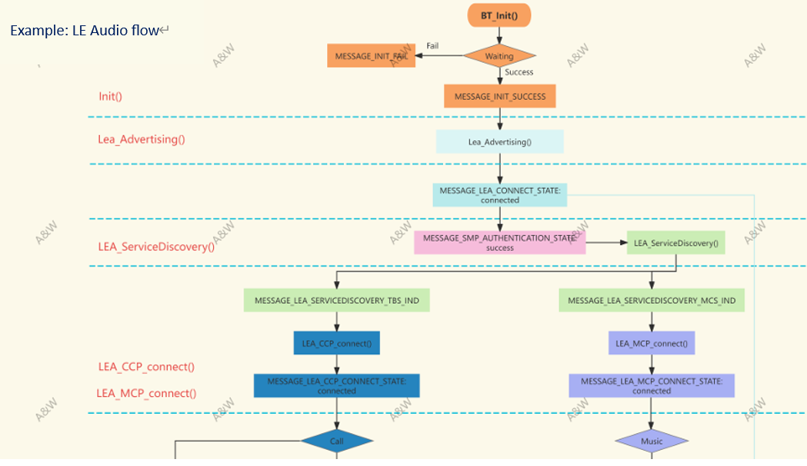
App level flow charts / Command Line

Slide 5
YAMAHA Motor A&W Solution Q&A (11/21)
Q8: In order for Yamaha to consider whether to recommend A&W Solution to Tier 1 within the company, please answer the following questions about your loyalty image.
Case 1: CP/AA + ECNR + BT Stack Royalty for High-End Products (Condition: 10,000/year)
Case 2: BT Stack Royalty for All Products (Condition: 200,000-500,000/year)
A8: BT stack only : USD 0.3 /per pcs
BT stack +CarPlay : USD 0.65 /per pcs( + USD 0.25 for Android Auto)
ECNR : Need to clarify what to do

