Slide 1
ALPINE CP/AA & Google Assistance Q&A (10/22)
Questions about CP/AA & Google Assistance for ALPINE(Yoshikawa)
Q1: In what form will A&W's CP/AA Solution be provided to customers?
For example, as a module incorporating CP/AA? Or as a CP/AA Solution package including Audio/Video?
A1: A&W CP/AA Solution: Simplified Integration & Certification (e.g., Facet, PCTS, ITU-T…)
1. Integration & Platform Customization:
Newest CP/AA Protocol Implementation
Platform Integration including Audio, Video, USB, and Bluetooth, USB iAP2 Gadget Driver and performance tuning assistance.
Device Management : for multi-device arbitration and handling certification-required scenarios (e.g., reconnection).
Resource Management: for CP/AA-related resource control (e.g., screen priority, audio routing).
2. Certification Expertise & Support:
A&W Core Strengths( Bluetooth and ECNR ): allowing A&W to rapidly diagnose issues and provide solutions.
Pre-testing services: help analyze call recordings to identify and resolve problems before official certification test.
Provide in-depth support for resolving difficult test items, with proven expertise in areas like Connection stability, Audio quality,
and RTD measurements.

Slide 2
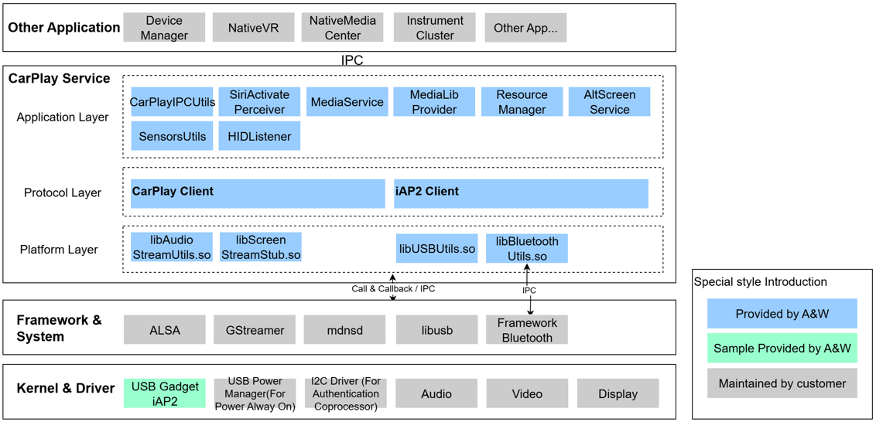
A&W CarPlay Service Block Diagram

Slide 3
ALPINE CP/AA & Google Assistance Q&A (10/22)
Q2: Please provide materials that provide an overview of the functions of the A&W ECNR evaluation tool.
A2: Please see attached document for the overview of the functions of ECNR Tuning Tool and ECNR Auto-tune Tool.
Expert_Config_tool_gui_eng_240729e.pdf -> The user manual of ECNR Tuning Tool
Tuning processing example-AnW_ConfigTool.pdf -> Examples how to tune ECNR parameters with ECNR Tuning Tool (Config Tool)
ECNR auto-tune tool instructions.pdf -> Instructions how to use ECNR Auto-tune Tool
Q3: ALPINE would like to hear about any solutions A&W has for Google Assistant.
A3: 1. For Head Units adopting Android Automotive OS (AAOS) and requiring integrated Google services
(such as Google Assistant, Google Maps, and the Google Play Store):
    A&W's Multi-channel Acoustic Echo Cancellation solution effectively improves the Voice Recognition Rate.
    A&W's Bluetooth Solution can pass the CTS (Compatibility Test Suite) required for GAS (Google Automotive Services) Certification.“
2. For Android Auto , our customer's head unit already supports Google Assistant via Android Auto."

Slide 4
ALPINE CP/AA & Google Assistance Q&A (10/31)
Q4: The other thing I wanted to ask about is support for GAS certification.
ALPINE understand that your company understands the certification requirements for both CP and AA, and that you also provide support for obtaining certification as part of your Solution.
ALPINE would like to know whether you are considering a similar certification support solution for GAS, and if so, when that solution will be available.
A4:

