Slide 1
ALPINE Wi-Fi authentication environment Q&A (10/17)
Questions about Wi-Fi authentication environment for ALPINE
Q1:
[Background]
ALPINE are currently preparing a Wi-Fi certification environment for a product we are developing at ALPINE (which uses your BT Stack/ECNR).
We have begun preparing the Wi-Fi certification environment for the DUT (vehicle equipment) based on information obtained from the chip vendor, Infineon (Cypress).
However, the information (procedures) we received from Infineon do not clearly explain what we need to do specifically to create an authentication environment for the DUT (vehicle equipment) that matches the actual product specifications, and we are having trouble figuring it out.
[Question]
If you have any knowledge about creating an environment for A&W products using Infineon chips to submit to a Wi-Fi certification authority, we would appreciate your advice.
Specifically, we are looking for information on creating an environment for the actual device (such as a navigation system) to be submitted to a Wi-Fi certification authority.
For reference, we are sharing the information we obtained from Infineon in the box below.
If you have any knowledge about creating a Wi-Fi certification environment for products using Infineon chips, we would appreciate your advice.
[Reference Information]
https://alpsalpine.box.com/s/dbdvm5k06eyuwg4pbbbce0t6dsap4zb3
Password: anwalap27bb
BOX Path: 20251017_WiFiSupportTask
File:
・Keyfob Release 89373 SDIO.zip … Complete set of software and instructions obtained from the chip vendor (Infineon).
・ReferenceMaterials/Infineon-AN234191_Wfa_test_setup_for_11n_ac_ax_p2p_certification_for_infineon_linux-based_platforms-ApplicationNotes-v05_00-EN.pdf … Infineon's instructions for setting up the WFA certification environment.
A1:Regarding the Wi-Fi certification process, we know that the combo chip maker or module maker needs to provide a test tool (Sigma tool) and firmware to the IVI manufacturer for integration. The tool is then submitted to the test lab for testing according to the Wi-Fi certification test environment. If there are any certification issues, the module maker or chip maker will provide assistance.

Slide 2
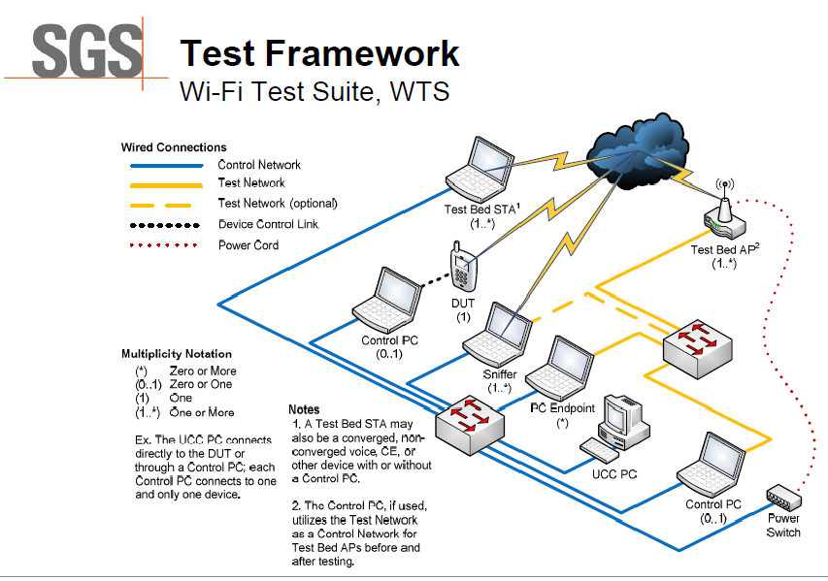
ALPINE Wi-Fi authentication environment Q&A (10/17)

