Slide 1
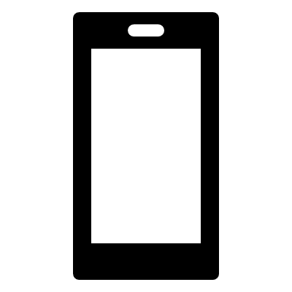

PoC Image #2
Confidential
A&W’s scope
Gateway Unit
（External AMP system)
IVI (Navigation, Display Audio) with CarPlay (R9)
BT/Wi-Fi
or
USB
4ch
SoC
MCU
All CarPlay Packets from iPhone without conversion will be sent to H/U.
Data Receiver
R9
Wi-Fi
Receiver
UI
CarPlay
or Bonjour
Video
Data Receiver
Media application
Audio Signal
CarPlay
(All packets)
USB
USB
Receiver
DSP
CarPlay
Communication plug-in
CarPlay Emulator
R9
Regular Audio
Signal Processing Flow
CarPlay
CarPlay
2ch
2ch
Auth IC?
All packet data
Spatial Audio
（Main Buffered Audio）
CarPlay Packets except for
Spatial Audio
Only CarPlay Packets
related to Spatial Audio will be decoded
CarPlay Packets
related to Spatial Audio
4ch
4ch
CarPlay SDK
Signal Processing
Mixer /
Switcher
APAC

Slide 2
Case #2 Software Requirement Analysis
Requirement “Only CarPlay Packets related to Spatial Audio will be decoded”
  No change:
  Requirement for hijacking packets: Hijacking remains necessary because the dongle is responsible for recognize and decrypting Spatial Audio packets and subsequently forwarding them to the DSP.
Requirement “All CarPlay Packets from iPhone without conversion will be sent to H/U.”
  New risk on HU:
  Sending unanticipated packet types to the Head Unit's (HU) CarPlay plugin leads to unknown or unpredictable behavior, including but not limited to:
    Spatial Audio packets
    AAC packets (expected to be PCM)
    Other new packet types introduced from R9
    …
Case #1's risk remains

Slide 3
#2 Q&A
Q1 : Case#2に関して、Gateway UnitとHead Unit間のCarPlay接続は実現できそうでしょうか？
A&W:
==========================
Points:
This concept is fundamentally different from wireless to USB products on the market.
Off-the-shelf products don't need to parse or extract packet content; they merely pass data from one hand to the other.
The product proposed here, however, must parse the CarPlay (CP) protocol and decrypt the spatial audio packets.
Since you cannot obtain the CarPlay session keys from both the head unit and the iPhone, as a man-in-the-middle, you would have to simultaneously implement the roles of a “CP accessory” and a “CP iPhone”.
This involves maintaining separate keys for both the iPhone and the head unit, which is essentially a hijack.
While there's official Apple source code for a CP accessory plugin that can be referenced, the role of a CP iPhone is unprecedented.
Although “theoretically feasible”, its implementation would inevitably require Apple's support.
Conclusion:
Theoretically feasible but Apple's stance therefore becomes critical.

Slide 4
#2 Q&A
Q2 :
>Although “theoretically feasible”, its implementation would inevitably require Apple's support.
上記内容に関して、CP アクセサリ プラグインの公式 Apple ソース コードを参考にすれば基本的には実現可能だが、何かあった場合にはAppleのサポートが必要という意味合いなのか、Apple ソース コードだけではそもそも実現できずにAppleのサポートは必須、なのか何れの意味合いですか？
A&W:
==========================
For case #2, it avoids packet content translation by merely decrypting packets with the iPhone-Dongle key and then encrypting them with the Dongle-Head Unit key. This approach significantly reduces implementation effort.
However, case #1 presents inherent risks, such as the unknown behavior of ACP 3.0's iPhone-side simulation during implementation, and certification risks still persist.
In short, That's correct. Theoretically, it's achievable by referencing the CarPlay plugin's source code and behavior. However, should any issues arise, Apple's support would be required, making Apple's stance crucial.

Slide 5
#3 Q&A
Q3 :
>>Theoretically, it's achievable by referencing the CarPlay plugin's source code and behavior.
上記に関して、試しに実装して動作が確認できるようになるまで、どれ位の工数／工期がかかりますか？
A&W :
Based on the current assessment, assuming the hardware is ready and Apple support is available (as listed below), it is estimated that it will take approximately six months (with two engineers) to complete the product development and reach the prototype stage. The planned development items are as follows for your reference.
Task | Task | resource (man/month)
Apple Support | ACP Support | PIO
 | iAP Support
 | CP Session
 | Misc
Platform | Hardware/Driver Check | PIO
Accessory | porting | 1
CP USB | USB device | 4
 | USB role switch and power
 | USB host
 | Hijack packets
CP simulation (iAP) | iAP packet translate (ACP Check) | 2
 | USB Host and Device protocol | 2
CP simulation (Session) | CP packet translate | 6
 | TCP/IP translate | 1
 | USB NCM mapping | 1
Spatial Audio | Function/Decrypt | 1
 | Routing

Slide 6
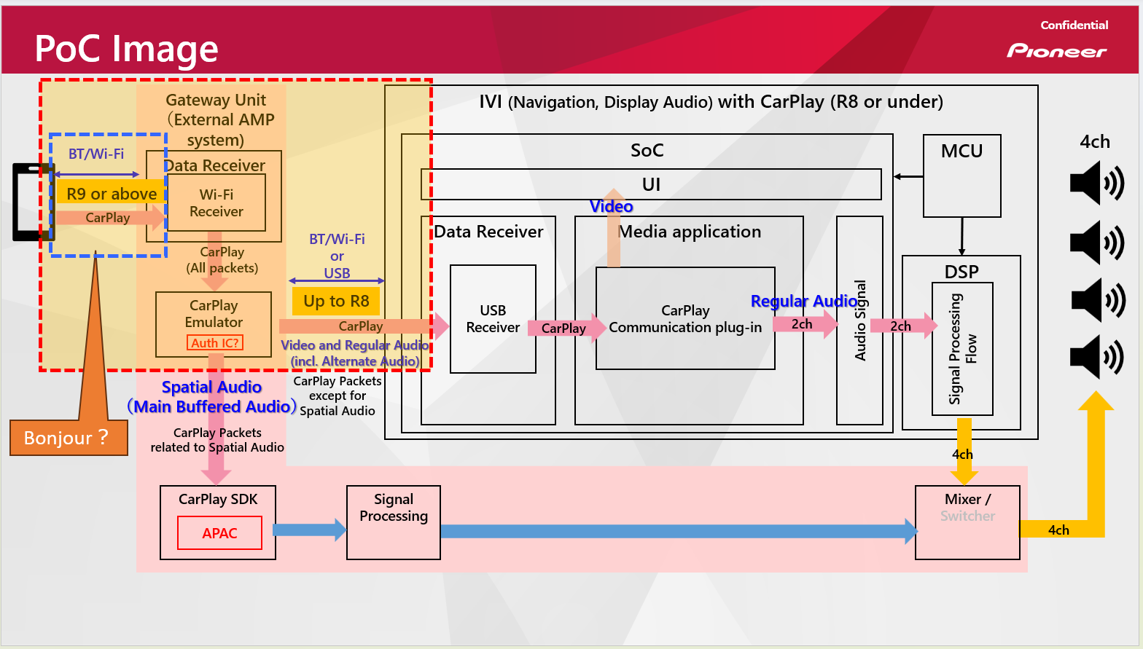

Slide 7
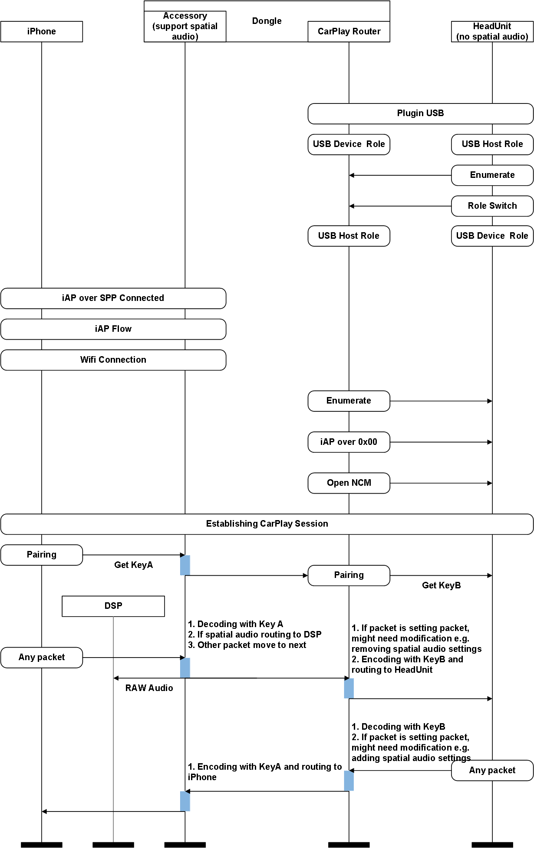

Slide 8
Case #1 Critical / Risk Part - Ask Apple
Implemention
Establish wireless carplay between iPhone and Dongle, and establish USB carplay between Dongle simulating iPhone role and HU.
1. Can Dongle simulate iPhone. More details are as follows
1.1. Can Dongle use Authentication Coprocesser 3.0 chip as IPhone role to perform authentication check on response data from HU.
1.2 Can Dongle hijack all CarPlay protocol packets, parse and modify them so that they can convert between wired CarPlay packets and Wireless CarPlay packets. For example,
nowplaying converts between iap over usb and iap over carplay
audio data converts between PCM and AAC.
Dongle hijacks MainBufferedAudio data (Spatial Audio) to play separately.
Dongle needs to use Communication PluginR18 to communicate with iPhone via wifi, HU uses the old version of Communication Plugin(e.g. R16) to communicate with Dongle via USB.
  Are there any CarPlay protocol differences that are not mentioned in the Accessory Interface Specification CarPlay Addendum?
Certification
Is the dongle's authentication the same as the general carplay counterpart? If the authentication is the same, how to handle the following use cases?
UI (Facet ID: B0793, 55A17...): Long press the Siri button, HU cannot display the dongle name and prompt the user to connect to wireless CarPlay. It can only be initiated by the phone.
Multi-device switching (Facet ID: 70D77, 3D9FD ...): HU does not display the wireless carplay device list and cannot switch.
ITUT and Facet ID:3F560 : The routing between iPhone Dongle and HU may increase the delay.

Slide 9
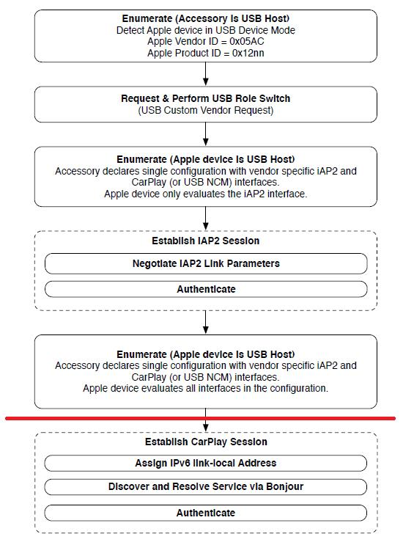
Q&A
Q1 : Does "If the CarPlay dongle does not need to fully follow the iPhone CarPlay USB device role" mean that it uses Bonjour, not CarPlay communication? Please explain in more detail.
A&W:
HeadUint
When the Dongle is plugged into the Head Unit, CarPlay communication only needs to occur above the red line in the diagram.
The communication below the red line happens after the Dongle's wireless CarPlay connects to the iPhone
Wireless CarPlay USB Dongle
USB
Receiver
CarPlay
Communication Plug-in

Slide 10
Q&A
Regarding certification, especially latency and audio quality, system-wide adjustments might be necessary to ensure proper compatibility.
Q3 : Also, how much time will be needed to study in more detail?
A&W:
1. Pioneer needs to obtain Apple’s certification test items for this product in order to determine if there are any special
testing requirements.
2. Based on the existing CarPlay certification test items, for example:
Latency issue: Wireless Round Trip Delay < 415ms, Reconnect < 3 seconds
Startup connection request latency will not exceed 7 seconds…
Siri : Leading Zero = 0, Max Zero = 0, Latency: (±300ms)…
Pioneer needs to confirm whether the existing head unit still has enough timing margin for the Wireless CarPlay dongle.
3. Does Pioneer know of any similar product that is already on the market and has passed certification, which can be used as a reference?

Slide 11
Q&A
2. There are some details we don‘t have experience with, so further study is needed to be more certain.
For example: USB interaction data between the CarPlay dongle and the IVI (e.g., USB role switching)
Conversion of CarPlay R9/R8 packets or audio formats, etc.
Q2 : Assuming that a more detailed study is necessary, can you give us an idea of ​​how
much work and time it will take to develop a PoC?
A&W:
Points:
a. “Modifications” to the control session content are required.
b. Spatial audio extraction, “decryption” and routing to DSP.
Both of the above points necessitate decoding and modifying packets. However, due to the encryption
of the CarPlay session, direct decoding and modification of the packets is not possible.
No good solution has been figured out yet.

Slide 12
Q&A
Q4: What kind of work is likely to occur regarding the Hardware/Driver Check of the PIO Task Platform?
  Verify that the development board has two USB ports, one with host capabilities and the other with OTG capabilities. Verify that the NCM host and NCM Gadget drivers are configured and functioning properly.
  b. Verify that the development board is connected to the ACP and functioning properly.
  c. Verify that the Wi-Fi/BT hardware is functioning properly. Verify that the Wi-Fi driver is functioning properly in AP mode 5G and that IE can be configured.
  d. Verify that the audio path is functioning properly (transmission rate, codec, and audio output).
Q5: Is it possible to shorten the development period by increasing resources?
It was determined that the main tasks could not be carried out in parallel, and that increasing manpower would not significantly shorten the completion time.
Q6: How much will it cost?
Q7: Is it possible to provide the deliverable in source code?

