Slide 1
ECNR
Good Experience:
Quickly adopted by major OEMs
1. Japan : AlpsAlpine
2. Global: : Continental(SG), Daiichi, Clarion(MY), Foxconn (Hon Hai)
3. China : Desay, HSAE, Lanyou (Nissan subsidiary)
Note: Certified by ITU-T and OEMs, outperforming competitors including global brands
Key Strengths:
1. Superior Algorithm Performance : Handles difficult Double Talk scenarios…
2. Complete Total System IOP:
- Real vehicle(small, medium, large) tests: highways, urban, mountain, extreme weather
(ex: strong wind, heavy rain, thunderstorms)…
- In-car noise interference tests: AC, passenger speech, navigation prompts …
- Voice recognition tests: ensures clear and stable speech under extreme conditions
3. ITU-T Tool: helps customers identify & solve system issues early. (ex: Bulk Delay, Sample Rate Mismatch…)
    Round Trip Delay ( RTD )
    Speech Quality During Single Talk
    Out-of-band Signals
    Echo performance without BGN
    Double talk performance
    Speech quality in the presence of BGN

Slide 2
ECNR
4. Intelligent & Real-Time Tuning Tool :
Enables faster, more accurate, and satisfactory tuning results, overcoming the limitations of manual adjustments.
    CarPlay SWB Receive/Send Speech quality testing:
    Traditionally requires multiple manual EQ adjustments to improve MOS scores.
    This tool automatically adjusts EQ by comparing ACQUA audio files, increasing MOS scores efficiently.
    RES (Residual Echo Suppressor) Parameter Tuning :
  Considers both TCL(Terminal Coupling Loss) and Double Talk conditions.
  This tool automatically tests multiple parameter combinations to achieve the best configuration.
    Automatically measure the delay between the reference signal and TXin (Mic-in), and provide a recommended solution.
    Automatic testing of different Echo tail settings, suggesting the optimal configuration.
5. Support for CP/AA: Improves speech recognition accuracy. Ensures compliance with ITU-T test items.
三 Extra Service:
1. Specially designed equipment :
Real vehicle validation, Detects potential issues early (ex: SPK, MIC, cabin acoustics…).
2. Supporting system-level challenges
A&W provides additional troubleshooting and solutions to help overcome system-level problems.
Example issues:
    Poor microphone/speaker linearity.
    Unstable delay between reference signal and microphone signal.
    Sampling rate mismatch between reference and microphone signals.
    Cabin reverberation and acoustic reflections.

Slide 3
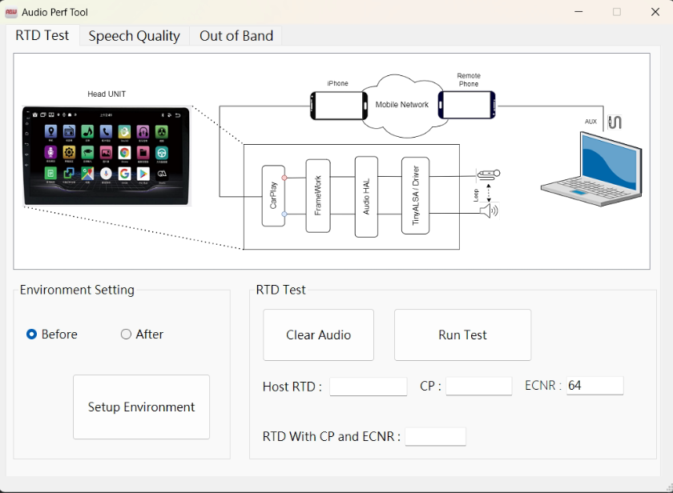
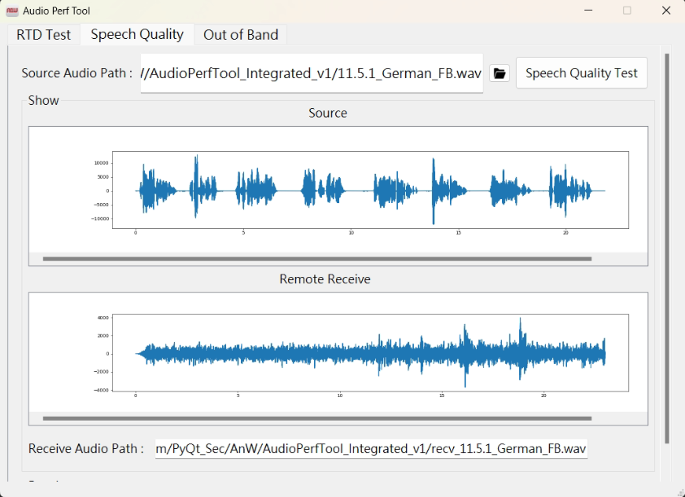
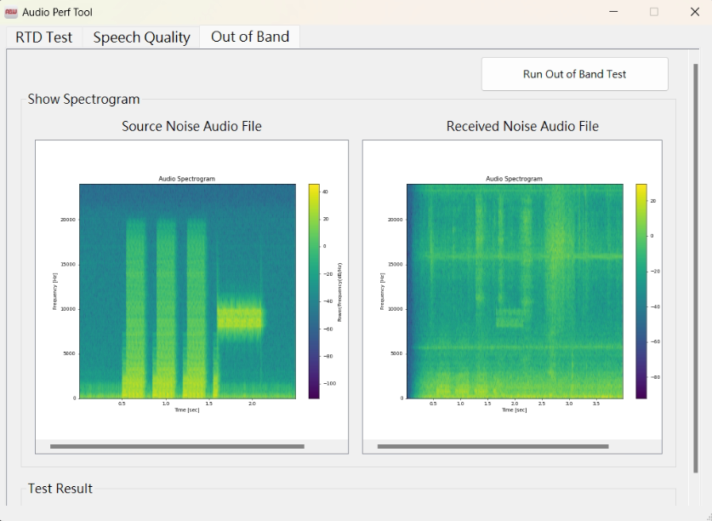
Examining Tool ( ITU-T)
  Round Trip Delay ( RTD )
  Sensitivity Frequency response
  Loudness Ratings
  Speech Quality During Single Talk
  Idle Channel Noise
  Out-of-band signals
  Echo Performance without BGN
  Double talk Performance
  Speech quality in the presence of BGN
  Absolute noise level
  DTMF cancellation

Slide 4
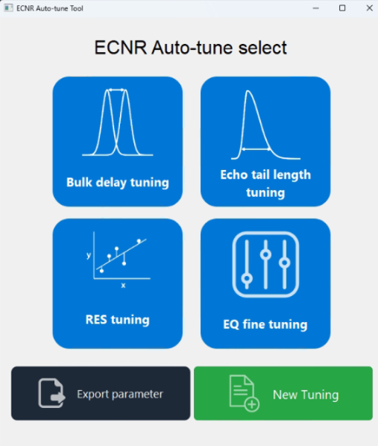
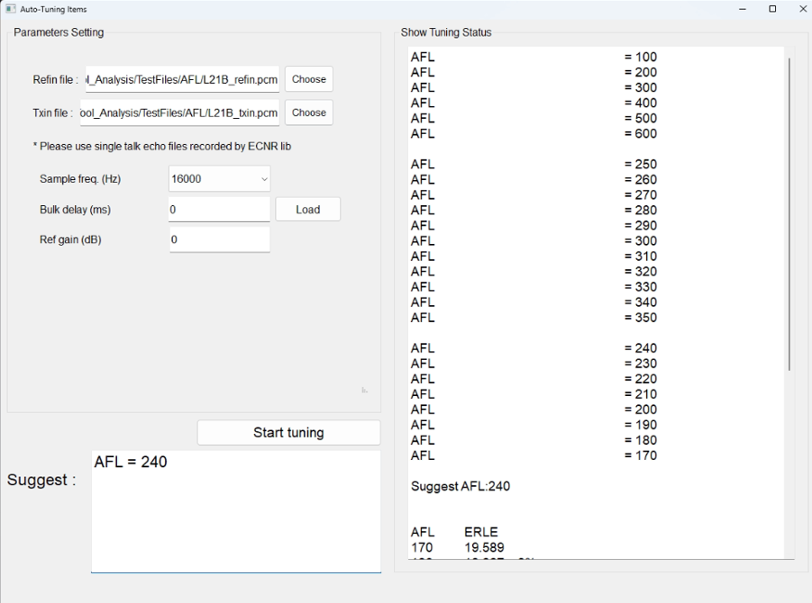
Examining Tool (Intelligent & Real-Time Tuning )
Echo tail length :

Slide 5
Appendix : A&W ECNR Advantages
Simple GUI tool for easy parameter settings
Tools for automatic major ECNR parameters adjustment (Bulk Delay, Echo tail length, EQ for SWB speech quality test…)
Good near-end speech quality preserved
Non-linear processing (NLP) for minimizing the impact of speaker non-linearity
Built-in input/output data recording mechanism for debugging
Rich experiences of ITU-T/CarPlay tuning
In-house Test tool for system verification before Lab test
Flexible customer support: on-site or remote
Good performance with affordable cost

