Slide 1
KAGA FEI-2-wheel Demo (STEP2) Q&A
Regarding to CES 2026, 3 features owned by AnW.
KEY FOB，BLE Device Identification
  AnW is checking visible solution and BT stack’s effort, will feedback in next week
Support Android Auto: (AnW Confirm OK)
  Considering G510 HW limitation, the demo strategy has:
    Wireless
    Touch Support
    Audio (Music, Navigation Hint)
    For AA-Call due to G510 +MT7921 no PCM interface so the HFP call no voice output .
Improved CarPlay connectivity (AnW Confirm OK)
  Optimized plan is IPC between BT and CP, while Wireless CarPlay Connected.
Kinno>We will hold a web conference with Kaga FEI on August 6th regarding the above response and the KEY FOB proposal.

Slide 2
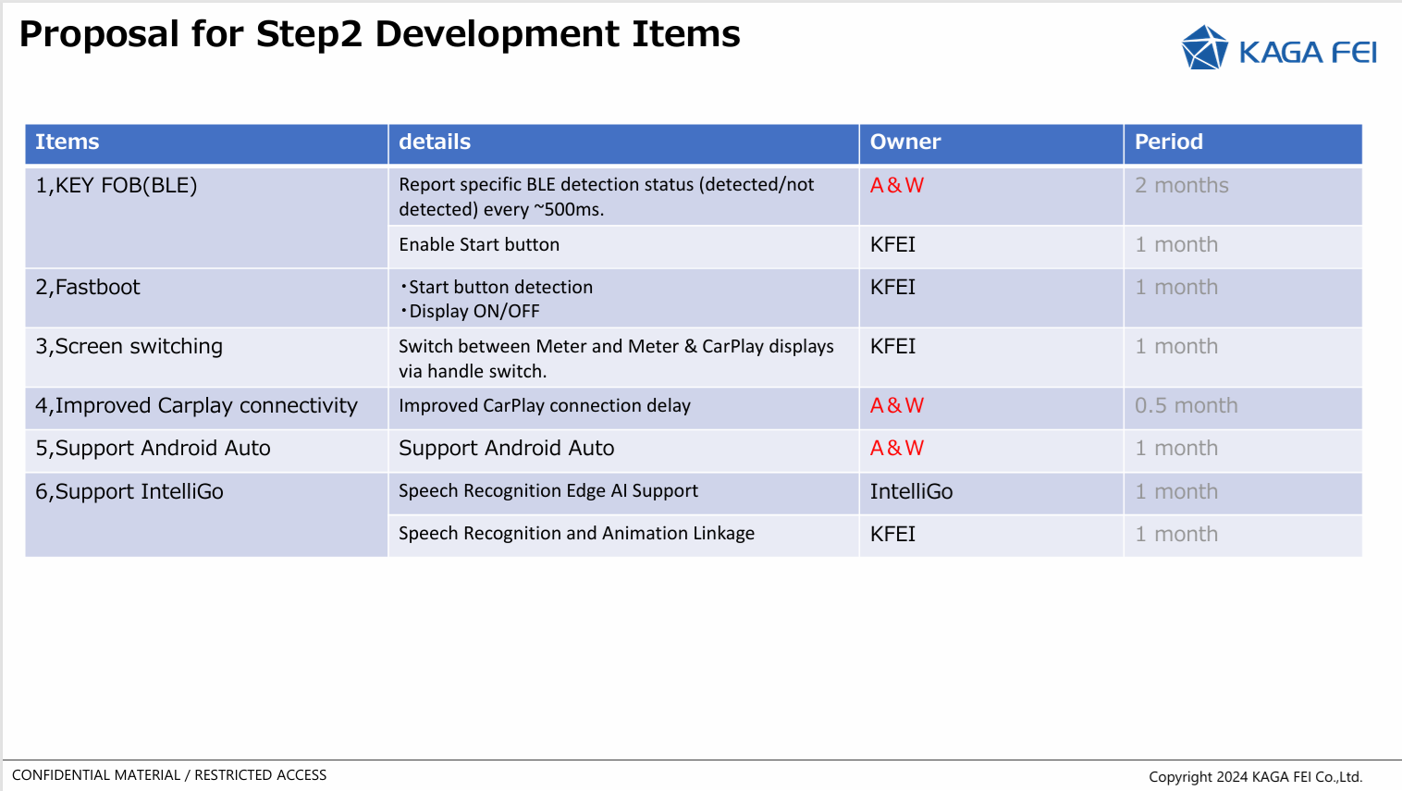
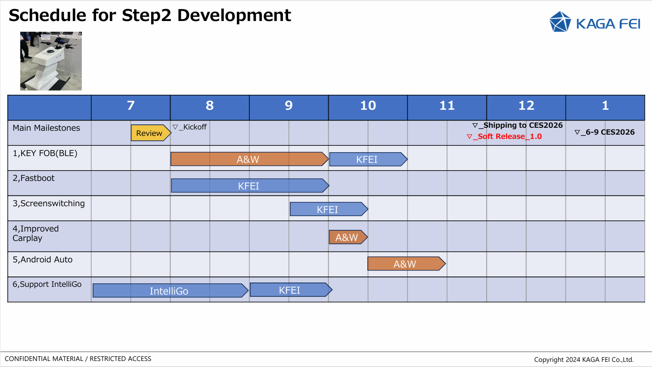
KAGA FEI-2-wheel Demo (STEP2) Q&A
Kaga FEI considers possibility of developing 2-wheel STEP2 Demo
  Kaga FEI Tobe-san explained the proposed specifications for the 2-wheel STEP2 Demo on the 15th.
  A&W will promptly consider the possibility of developing the following three of the five additional specifications.
  Kaga FEI intends to hold discussions on the results of the above considerations within July.

