Slide 1
NTT QNOQ Device 『 Vibration Voice Sensors + Air Mic 』Q&A１
NTT QNOQ Device “Vibration Voice Sensors + Air Mic” Demo request
  Mr. Tatsuki of NTT QNOQ Device asked me to introduce and demo Alango's "Vibration Voice Sensors + Air Mic".
  ※Since the contact email address for Alango Japan is Mr. Suzuki, Mr. Morishita forwarded the email internally to him.
  Tatsuki-san requested to be introduced to A&W this time, and the solution and demo information (URL) have been added.
  https://www.alango.com/smart-glasses.php
  https://www.linkedin.com/posts/alango-technologies_snapdragon-smartglasses-hearing-activity-7307372257679405058-t_Ka
  https://www.linkedin.com/posts/alango-technologies_more-from-global-audio-summit-alexander-activity-7310988114901037058-P4VZ
  Kinno>In order to contact Mr. Tatsuki, I asked Perry-san to provide the following information in advance.
  1. Is "Vibration Voice Sensors + Air Mic" an Alango solution?
  Yes, vibration sensor and mic array beamforming are an Alango solution for Smart glasses.
  2. If yes, could you send me detailed documentation in English?
  All the detailed information about Alango’s Smart glasses solution is on the web. Alango’s technology can separate wearer’s speech from speech captured from the field of view.
  3. Do you have a demo of the above solution?
  Currently Alango’s demo on the Qualcomm Snapdragon S7 smart glasses only showcases hearing enhancement, including far-field voice pickup with beamforming, omnidirectional pickup, hearing loss presets, and own-voice attenuation using a voice vibration sensor.
  Currently demo video is not available
  4. If there is a demo, could you send me a video of it?
  5. Lastly, can A&W sell this solution as an agent?
  Yes .
  A&W Question :
  1. What type of product do they plan to make?
  NTT QONOQ> NTT QONOQ targets the following second generation smart glasses product (scheduled for mass production in autumn 2026).
  MiRZA XRD-T01 | 株式会社NTTコノキューデバイス ｜ NTT QONOQ Devices, Inc.
  2. Do they need multiple microphones? How many?
  NTT QONOQ > NTT QONOQ's smart glasses (first product) consist of two microphones, one on each side (four in total).
  However, NTT QONOQ can consider the number of microphones required for Alamgo's smart glasses.
  3. We need more detail product information or their plan , we can discuss with Alango the best solution for them
  NTT QONOQ > Detailed requests from NTT QONOQ, questions to Alanogo, and deadlines for responses are listed in item 2 on page 2.

Slide 2
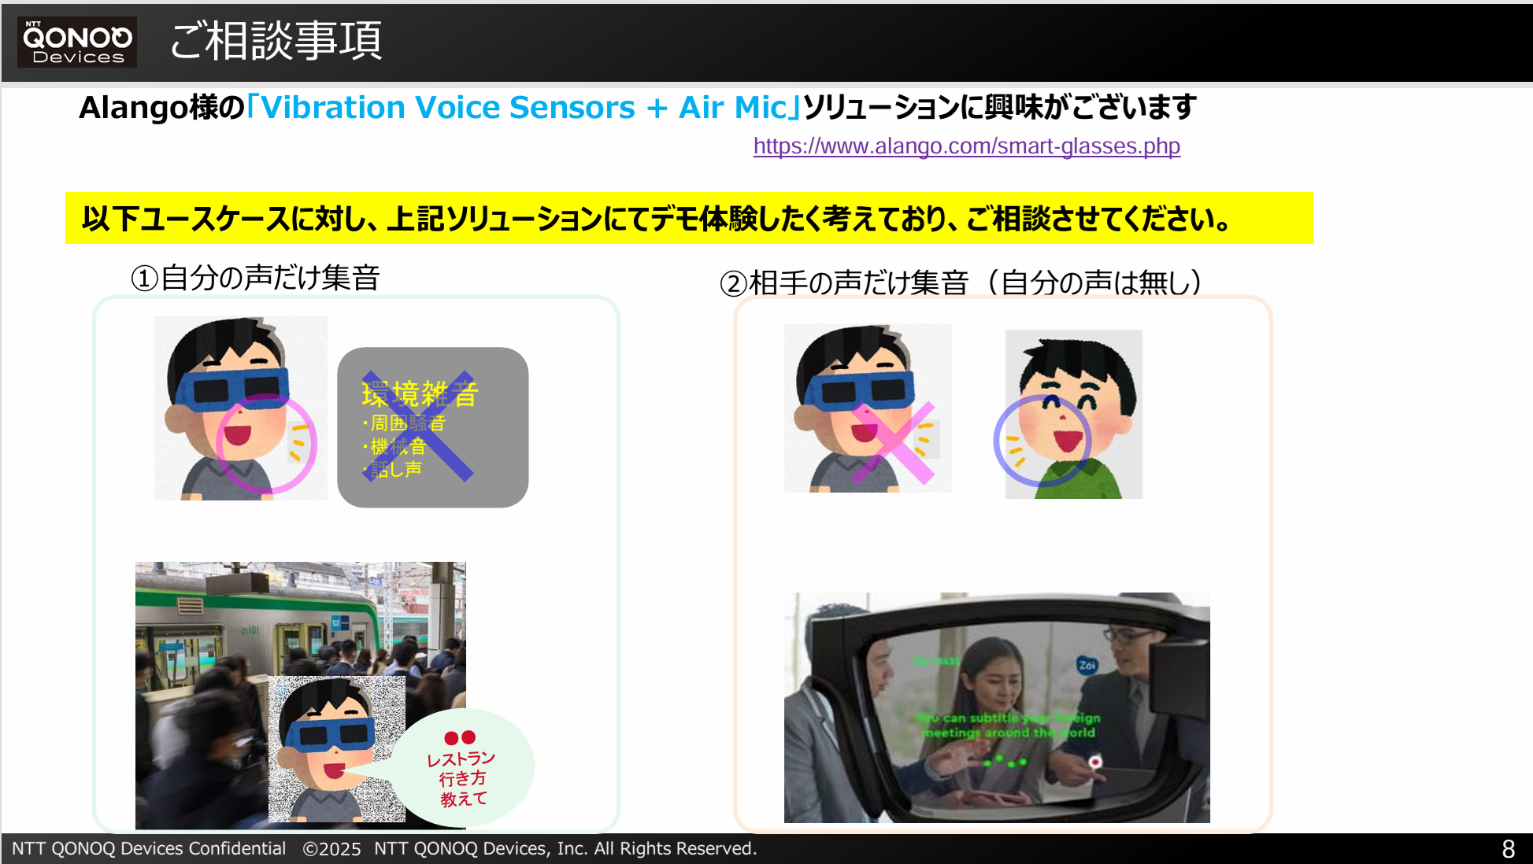
NTT QNOQ Device 『 Vibration Voice Sensors + Air Mic 』Q&A２
2. Below are the detailed requirements for NTT QONOQ Device.
  NTT QONOQ released their first smart glasses last year.
  MiRZA XRD-T01 | 株式会社NTTコノキューデバイス ｜ NTT QONOQ Devices, Inc.
  ※SOC uses Qualcomm's AR2 and features two microphones on each side.
  NTT QONOQ would like to confirm its performance by mid-August. (A demo of the actual device would be best.)
  ※The most interesting thing about NTT QONOQ is its support for "Vibration Voice Sensors.“
  ※ NTT QONOQ has two goals for the Alanogo Solution:
  Case1. Extract only the voice of the person wearing the glasses in a noisy environment.
  Case2. Extract only the voice of a specific person in a noisy environment
  (including removing the person's own voice).
  NTT QONOQ urgently needs to know the technical information available for the Alango smart glasses solution
  (microphone position, vibration voice sensors specifications, etc.) and whether there are any restrictions on provision.
  NTT QONOQ is also interested in whether the Alango smart glasses solution has already been adopted by a smart glasses vendor.
  If NTT QONOQ determine that the expected performance is achievable, he would like to discuss specific technical details and terms of provision (royalties, etc.) in the next step.
  NTT QONOQ is planning to launch smart glasses (second wave) in the fall of 2026, and intends to adopt the Alango smart glasses solution if conditions are right.
  Kinno> NTT QUNOQ would like to receive responses from Alango on the following three points by August 6th.
  (If a response by the 6th is not possible, we will provide a response date.)
  Q1 : A demonstration of the conduction microphone system or data appropriate for the experience
  >NTT QUNOQ understand that there are currently no conditions, such as exclusive to other companies.
  Q2 : Minimum microphone requirements (number of microphones, placement, etc., as envisioned by Alango)
  Q3 : SoCs expected to be supported (such as the two companies mentioned today that use glasses from other companies)

